Slide 1

THE AMERICAN COLLEGE
DEPARTMENT OF DATA SCIENCE – POST GRADUATION
PROJECT
SALES EFFECTIVENESS FOR BUSINESS
Guided by,
Presented by,
M.Gokulsundar,
22PDS11,
Department of Data Science - PG,
The American College.
Dr.Mr.SenthilKumar.,
Assistant Professor,
Department of Data Science - PG,
The American College.

Slide 2
TITLE EXPLAINATION
Sales effectiveness is the measure of how well a company's sales efforts achieve their intended goals and objectives. It encompasses various aspects of the sales process, including acquiring new customers, retaining existing ones, increasing sales revenue, and maximizing profitability. Effective sales strategies focus on understanding customer needs, communicating value propositions, and ultimately closing deals successfully. Key components of sales effectiveness include sales training, customer relationship management, sales forecasting, performance measurement, and continuous improvement. Ultimately, sales effectiveness is essential for driving revenue growth, maintaining a competitive edge, and achieving long-term business success.
TWO WAYS TO INCREASE THE SALES:
By products
By sales workers

Slide 3
SALES EFFECTIVENESS BY PRODUTS
Sales effectiveness for products refers to the ability of a company's sales efforts to successfully sell its products in the market. At its core, it involves understanding the needs and desires of customers and effectively communicating how a product addresses those needs. Sales effectiveness starts with a deep understanding of customer preferences, market trends, and the competitive landscape. Salespeople must possess comprehensive knowledge of the product, including its features, benefits, and unique selling points, to effectively convey its value to potential buyers. Building strong relationships with customers is essential for fostering trust and loyalty, which can lead to repeat sales and positive word-of-mouth referrals

Slide 4
THIS PROJECT CONCEPT IS SALES FFECTIVENESS BY SALES WORKERS
Sales effectiveness for sales agents across different locations is paramount for companies aiming to expand their market presence and cater to diverse customer bases. It involves adapting sales approaches to resonate with local cultures and market dynamics while maintaining consistency in messaging and brand representation. Centralized support, including comprehensive training and access to resources, ensures alignment across locations while empowering agents to address logistical challenges and regulatory requirements specific to their territories. Leveraging technology, such as CRM systems and predictive analytics, enables sales agents to optimize their strategies, prioritize sales efforts, and capitalize on emerging opportunities. Ultimately, by equipping sales agents with the tools, knowledge, and support they need to succeed in their respective locations, companies can drive sustainable growth and enhance their competitive advantage in local and global markets.

Slide 5
OVERVIEW
Objective
Abstract
Introduction
Problem Statement
Features details
Flowchart
Solution Statement
Existing algorithm
Proposed algorithm
Comparison of algorithm
Conclusion
Reference
Screen Shot

Slide 6
OBJECTIVES
Effective sales strategies begin with a clear understanding of the target market and customer needs.
This project proposal aims to explore the application of data science techniques to enhance sales effectiveness within an organization.

Slide 7
ABSTRACT
Sales effectiveness is a critical aspect of any organization's success in today's competitive business landscape. This abstract explores the key components and strategies for enhancing sales effectiveness. Effective sales strategies begin with a clear understanding of the target market and customer needs. By defining ideal customer profiles and aligning sales approaches accordingly, organizations can better position their products or services to meet customer demands.
Performance management is another critical aspect of sales effectiveness. Regular performance reviews and feedback sessions help identify areas for improvement and recognize top performers, driving continuous growth and development within the sales organization.
Sales enablement plays a significant role in supporting sales effectiveness by providing sales teams with the tools, technologies, and resources they need to succeed. From CRM systems and sales automation tools to marketing collateral and sales playbooks, enabling technologies streamline sales processes and enhance productivity.
Building and maintaining strong customer relationships is fundamental to sales effectiveness. By prioritizing personalized interactions, timely follow-ups, and excellent customer service, organizations can foster trust and loyalty, leading to increased customer retention and referrals.
In conclusion, enhancing sales effectiveness requires a multifaceted approach that addresses various aspects of the sales process, including strategy, processes, people, and technology. By implementing these strategies and continuously refining sales efforts, organizations can drive sustainable growth and success in today's dynamic marketplace.

Slide 8
PROBLEM STATEMENT:
Client: Sales Effectiveness | Category: Product Sales
FicZon Inc is an IT solution provider with products ranging from onpremises products to SAAS based solutions. FicZon major leads generation channel is digital and through their website.
FicZon business is majorly dependent on the sales force effectiveness. As the market is maturing and more new competitors entering the market, FicZon is experiencing the dip in sales.
Effective sales is dependent on lead quality and as of now, this is based on manual categorization and highly depended on sales staff. Though there is a quality process, which continuously updates the lead categorization, it’s value is in for post analysis, rather than conversation.
FicZon wants to explore Machine Learning to pre-categorize the lead quality and as result, expecting significant increase in sales effectiveness.

Slide 9
PROJECT GOAL:
Data exploration insights – Sales effectiveness.
ML model to predict the Lead Category (High Potential, Low Potential).

Slide 10
Basic Check
EDA
Data preprocessing
EDA Problem solving
Sales Effectiveness
Load Dataset
Import basic modules
Splitting
Encoding
Existing Algorithm
Model Creation
Proposed Algorithm
Multilayer perceptron
Support vector classifier
Decision Tree
Random Forest Classifier
XGBoost Classifier

Slide 11
FEATURE DETAILS:
RangeIndex : 7422 entries, 0 to 7421
Data columns : Total 9 columns
Created : Product created date and time
Product_ID : Product Id
Source : Product Sales Sources
Mobile : Customers Mobile Number
EMAIL : Customers Email ID
Sales_Agent : Sales agent for product sales
Location : product sales location
Delivery_Mode : product delivery mode

Slide 12
LABEL DETAILS STATUS
Junk Lead
Not Responding
Just Enquiry Low potential (Negative process)
Long Term
In Progress Negative
Lost
Converted
Potential
In Progress Positive High potential (Positive process)
Open
Converted

Slide 13
SOLUTION STATEMENT:
First of all, I import basic modules, load data and basic check:
Import Seaborn – It also visual the data
Import Pandas
Import numpy
load data:
And I load the data
Basic check:
I do some basic check like, shape of the data and describe the data and know the mean, std, mode, min value and max value from the data.

Slide 14
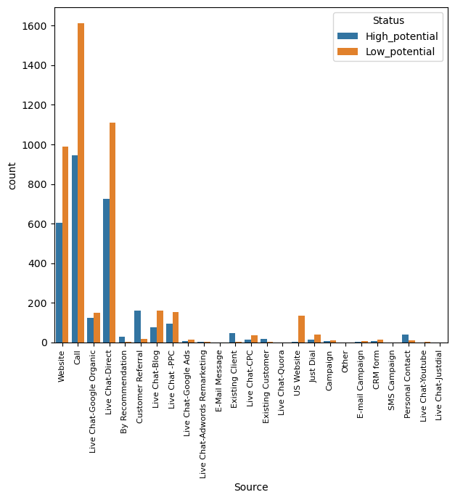
PROBLEM SOLVING:
The main Aim of project is to find the sales effectiveness, and find how to increase the sales effectiveness.
I’m used EDA to find the sales effectiveness and how to increase the positive effectiveness.
Source:
Insights:
You used call source more but it gave half positive response.
And Live chat is good response.
And you can improve customer Referral source, because it gave more positive response for small amount of data.
And same way you can improve the Existing client also.

Slide 15
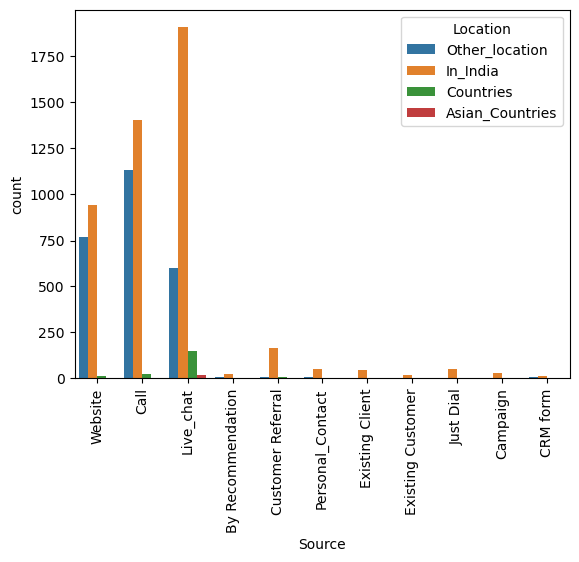
Source * Location:
Insights:
You used every source in inside India and other location.

Slide 16
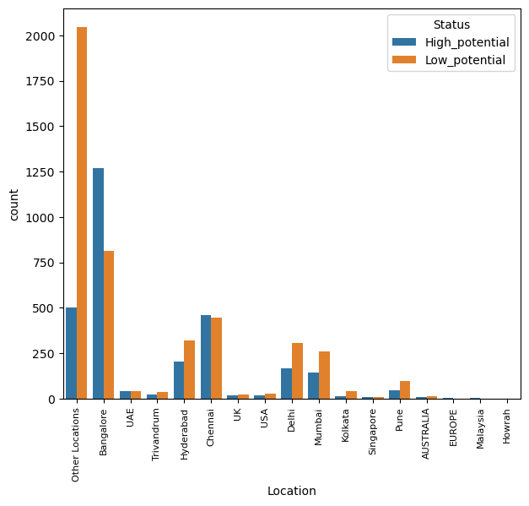
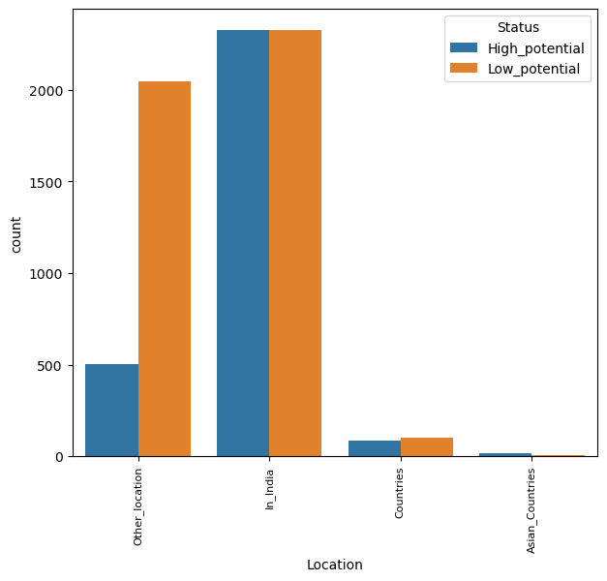
Location:
Insights:
In Location you used to much of other location but no use, it giving negative response.
You can increase the inside India location, particularly in Bangalore and Chennai.
You can increase countries location.
You can decrease the other locations.

Slide 17
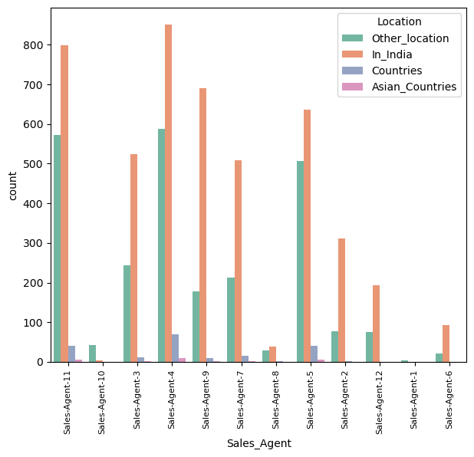
Sales Agent:
Insights:
Sales Agent in Location:
Every agent works more in inside India,
And other locations.

Slide 18
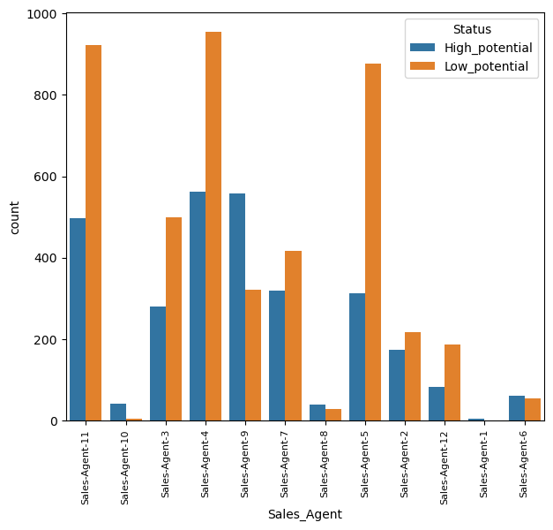
Sales Agent and Target:
Insights:
You used Agent 4,11,5 more, 4,11 it’s ok, it giving half off positive response but 5 works waste you can remove agent 5.
And you can increase the agent 9,10 task, because it works well.
You can decrease the task for agent 11,9,5.

Slide 19
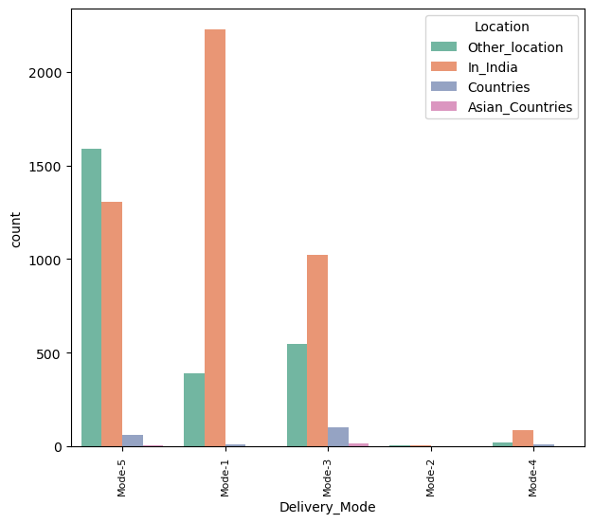
Delivery Mode in Location:
Insights:
mode works in In India and other locations.

Slide 20
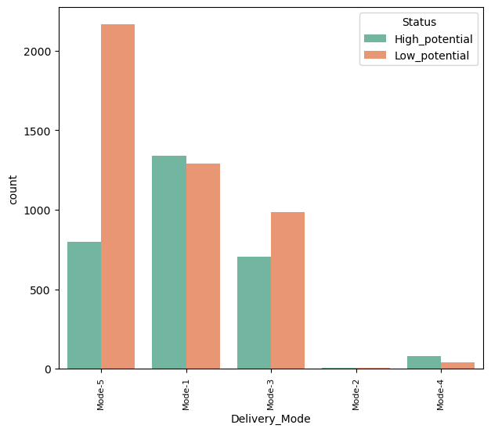
Delivery Mode In Target:
you used Mode 5 more, but it giving maximum negative response.
But Mode 1 is performing well, you can improve Mode 1 and 3

Slide 21
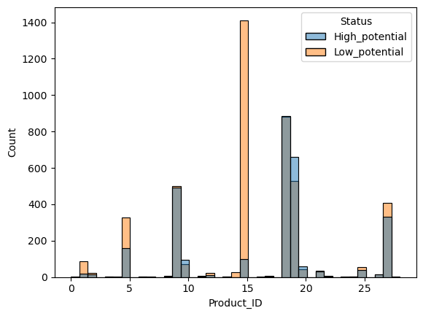
Product_ID *Target:
Insights:
You used 15th product more but its response negative
You can increase the 18th to 20th product more because it giving positive response.
And you can avoid 15th ,5th, and 1st products.

Slide 22
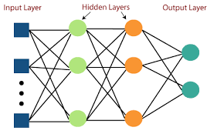

EXISTING ALGORITHM
Multi-Layer Perceptron and SVM
The MLP (Multi-Layer Perceptron) classifier is a type of artificial neural network (ANN) commonly used in machine learning for classification tasks. It belongs to the family of feedforward neural networks, where information flows in one direction, from input nodes through hidden layers to output nodes.
SVM is a powerful supervised algorithm that works best on smaller datasets but on complex ones.
Support Vector Machine, abbreviated as SVM can be used for both regression and classification tasks, but generally, they work best in classification problems.

Slide 23
EXISTING ALGORITHM WORKS IN THIS PROJECT: MLP (Multi-Layer Perceptron):
The MLP (Multi-Layer Perceptron) classifier is the one of the ANN(Artificial Neural Network).
The MLP (Multi-Layer Perceptron) classifier works poorly because the MLP good perform in large datasets.
The MLP (Multi-Layer Perceptron) classifier works in this project underfitted, may be large dataset works properly.
The Accuracy is
Training score 0.69
Testing Score 0.68
f1 score 0.52
Cross validation:
Cross validation is model evaluation method:
In this method std(standard deviation) is less than 0.05 is a Good model, greater than 0.05 is bad model or not suitable model in this dataset.
In MLP cross validation score is 0.069, so it is a bad model.

Slide 24
EXISTING ALGORITHM WORKS IN THIS PROJECT: SVC(Support Vector Classifier):
SVC(Support Vector Classifier) is the concept of Support Vector Machines (SVM), which aims to find the optimal hyperplane that best separates the data points into different classes.
In this project, SVC works not good because in dataset most of the attributes are categorical so the encoding is fixed values not random values so the works not properly.
The Accuracy score is:
Training Score : 0.70
Testing Score : 0.70
f1 score : 0.52
Cross Validation score:
In this method std(standard deviation) is less than 0.05 is a Good model, greater than 0.05 is bad model or not suitable model in this dataset.
The cross validation score is 0.067

Slide 25
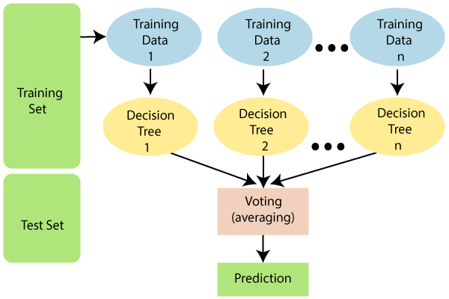
PROPOSED ALGORITHM
RANDOM FOREST ALGORITHM
Random Forest is a popular machine learning algorithm that belongs to the supervised learning technique. It can be used for both Classification and Regression problems in ML. It is based on the concept of ensemble learning, which is a process of combining multiple classifiers to solve a complex problem and to improve the performance of the model.
"Random Forest is a classifier that contains a number of decision trees on various subsets of the given dataset and takes the average to improve the predictive accuracy of that dataset."
The greater number of trees in the forest leads to higher accuracy and prevents the problem of overfitting.

Slide 26
PROPOSED ALGORITHM WORKS IN THIS PROJECT: Random Forest Classifier:
Random Forest Classifier the concept of ensemble learning, which is a process of combining multiple classifiers to solve a complex problem and to improve the performance of the model.
Random Forest Classifier works in this project, is really perform good. Because it have ensemble technique so a process of combining multiple classifiers to solve a complex problem and to improve the performance of the model.
Cross validation score is std is less than 0.05, so it is perform good.
It little overfitted but f1 score 0.63 is good.
Before hyperparameter tuning:
Training time : 00:01.10 Sec
Training score : 0.78
Testing Score : 0.72
f1 Score : 0.62
hyperparameter tuning training timing : 00:01.40 Sec
After hyperparameter tuning :
Training timing : 00:01.13 Sec
Training Score : 0.77
Testing Score : 0.72
f1 Score : 0.63
Cross validation Score : 0.0064

Slide 27
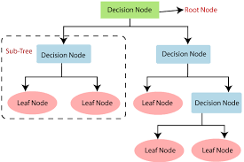
PROPOSED ALGORITHM
Decision Tree
Decision trees are a popular supervised learning algorithm used for both classification and regression tasks. They are intuitive and easy to understand, making them valuable for both analysis and prediction.
Decision trees are prone to overfitting, especially when they are deep and complex. Overfitting occurs when the model captures noise or irrelevant patterns in the training data, leading to poor generalization on unseen data.
Techniques like pruning, setting maximum depth, or using ensemble methods like Random Forests can mitigate this issue.

Slide 28
PROPOSED ALGORITHM WORKS IN THIS PROJECT: Decision Tree Classifier:
Decision Tree Classifier works by partitioning the feature space into a set of rectangular regions and then assigning a class label to each region based on the majority class of the training data points within that region.
In this project, Decision Tree Classifier performs well.
Cross validation score is std is less than 0.05, so it is perform good.
Compared with other two algorithm the f1 score is poor.
Before hyperparameter tuning:
Training time : 00:01.18 Sec
Training score : 0.78
Testing Score : 0.72
f1 Score : 0.60
hyperparameter tuning training timing : 00:02.17 Sec
After hyperparameter tuning :
Training timing : 00:01.13 Sec
Training Score : 0.74
Testing Score : 0.72
f1 Score : 0.59
Cross validation Score : 0.00044

Slide 29
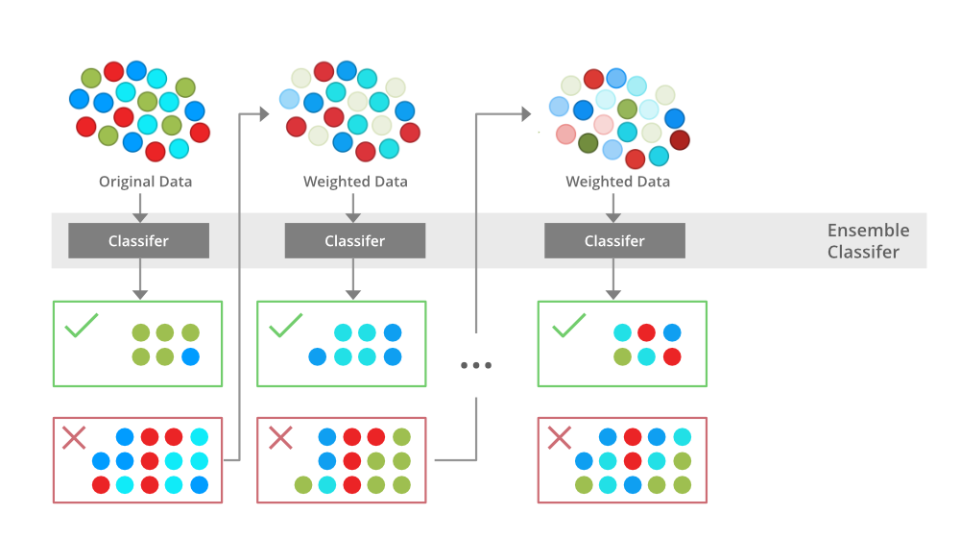
PROPOSED ALGORITHM XGBoost
XGBoost is highly optimized for performance and efficiency. It utilizes parallel and distributed computing techniques to speed up training and prediction, making it suitable for large datasets.
Regularization XGBoost includes built-in regularization techniques to prevent overfitting, such as L1 (Lasso) and L2 (Ridge) regularization.
These techniques penalize complex models, leading to improved generalization performance.
Flexibility XGBoost supports various loss functions and evaluation metrics, allowing users to customize the model according to the specific requirements of their task.
XGBoost provides a feature importance score, which indicates the relative importance of each feature in making predictions. This information can help users understand the underlying patterns in the data.

Slide 30
PROPOSED ALGORITHM WORKS IN THIS PROJECT: XGBoost(eXtreme Gradient Boosting)
XGBoost works eXtreme Gradient Boosting, is a powerful and popular machine learning algorithm that belongs to the class of ensemble learning techniques. Specifically, it's an implementation of gradient boosting algorithms.
In this project, XGBoost works well but hyperparameter tuning training timing is more.
Cross validation score is std is less than 0.05, so it is perform good.
Training and testing is good not overfitted but compared with Random Forest Classifier the f1 score is low.
But this also good model.
Before hyperparameter tuning:
Training time : 00:01.20 Sec
Training score : 0.76
Testing Score : 0.72
f1 Score : 0.61
hyperparameter tuning training timing : 18 minute
After hyperparameter tuning :
Training timing : 00:01.29 Sec
Training Score : 0.73
Testing Score : 0.72
f1 Score : 0.61
Cross validation Score : 0.0304

Slide 35
COMPARISON OF ALGORITHMS:
objective | Random Forest | Decision Tree | XGBoost
Performance | Performs Good in this project. | Performs Good in this project. | Performs Good in this project.
Overfitting | Little overfitted | normal | No overfitted
Underfitting | No underfitting | No underfitting | No underfitting
Training Time | Compared with other two models the Training timing is less in Random forest Algorithm. | Compared with Xgboost the Decision Tree is less Training Time but compared with Random Forest model the training time is higher in Decision Tree model. | Compared with other two models Training time is more in XGBoost.
Hyperparameter Tunning | The hyperparameter tunning works to find the best parameters for the model. Hyperparameter tunning time is less in Random Forest model compared with other two models. | Hyperparameter Tunning time in Decision Tree is greater than Random forest and lesser than Xgboost. | Compared with other two models, the XGBoost is more take time for hyperparameter tunning runtime.
After Parameter Tunning Training Time | It is less compared with other two models. | Its greater than Random forest and less than XGBoost. | Compared with other two models Xgboost is take extra time.

Slide 36
COMPARISON OF ALGORITHMS:
Objective | Random Forest | Decision Tree | XGBoost
Training Score | Compared with other two models the training score is higher. | Compared with Random forest the decision tree lesser and compared with Xgboost the training score is higher. | Compared with other two models the XGBoost is lesser.
Testing Score | same | same | same
F1 score | Its greater compared with two models | It is very lesser than two models | 1% lesser thsn Random forest. And greater than decision tree model.

Slide 37
COMPARISON OF ALGORITHMS:
Objective | Random Forest Classifier | Decision Tree Classifier | XGBoost Classifier
Cross validation Score | Its cross validation score lesser than 0.05. So its good model | Its cross validation score lesser than 0.05. So its good model | Its cross validation score lesser than 0.05. So its good model
Conclusion | It is a good model accuracy and f1 score also high but it little overfitted. Training score is higher compared with other two models. | It is a good model compared with other two models same accuracy, training score is less than Random forest and greater than xgboost. but F1 score is very low compared with other two model. | It is a good model same accuracy, training score also good F1 score is greater than decision tree and 2% less than Random Forest model.
Overall performance | It is good model, but little overfitted. Performance = Average | It is good model but f1 score is low Performance = Average | It is good model well train, test and f1 score also. This model is better than other two models. Performance = Good

Slide 38
SYSTEM DESCRIPTION
Hardware Requirements:
Operating System : Windows 10
RAM : 12.00G
System Type : 64-bit OS
Processor : Intel(R) core i3
Software Requirements:
Front-End : Python
Scripts : Python3.9 Shell
Tools : Jupyter Notebook

Slide 39
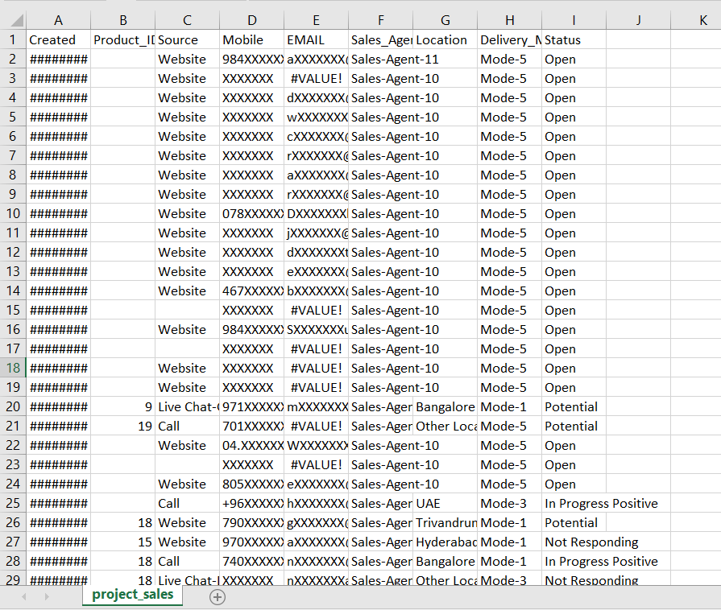
SREENSHOTS

Slide 40
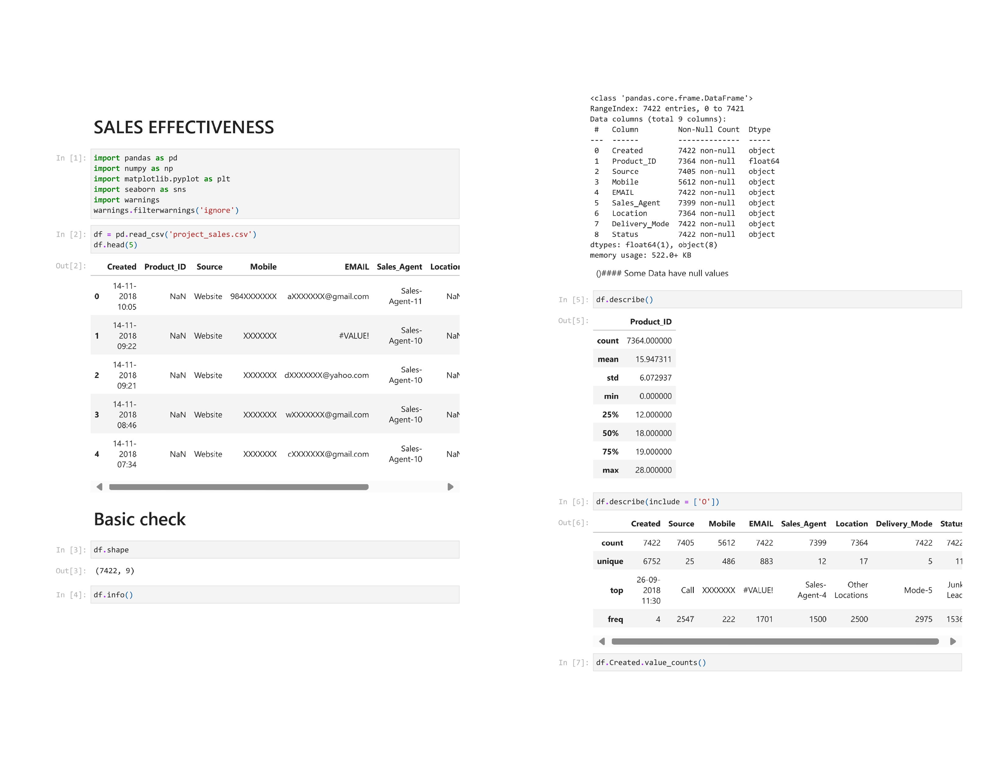

Slide 41
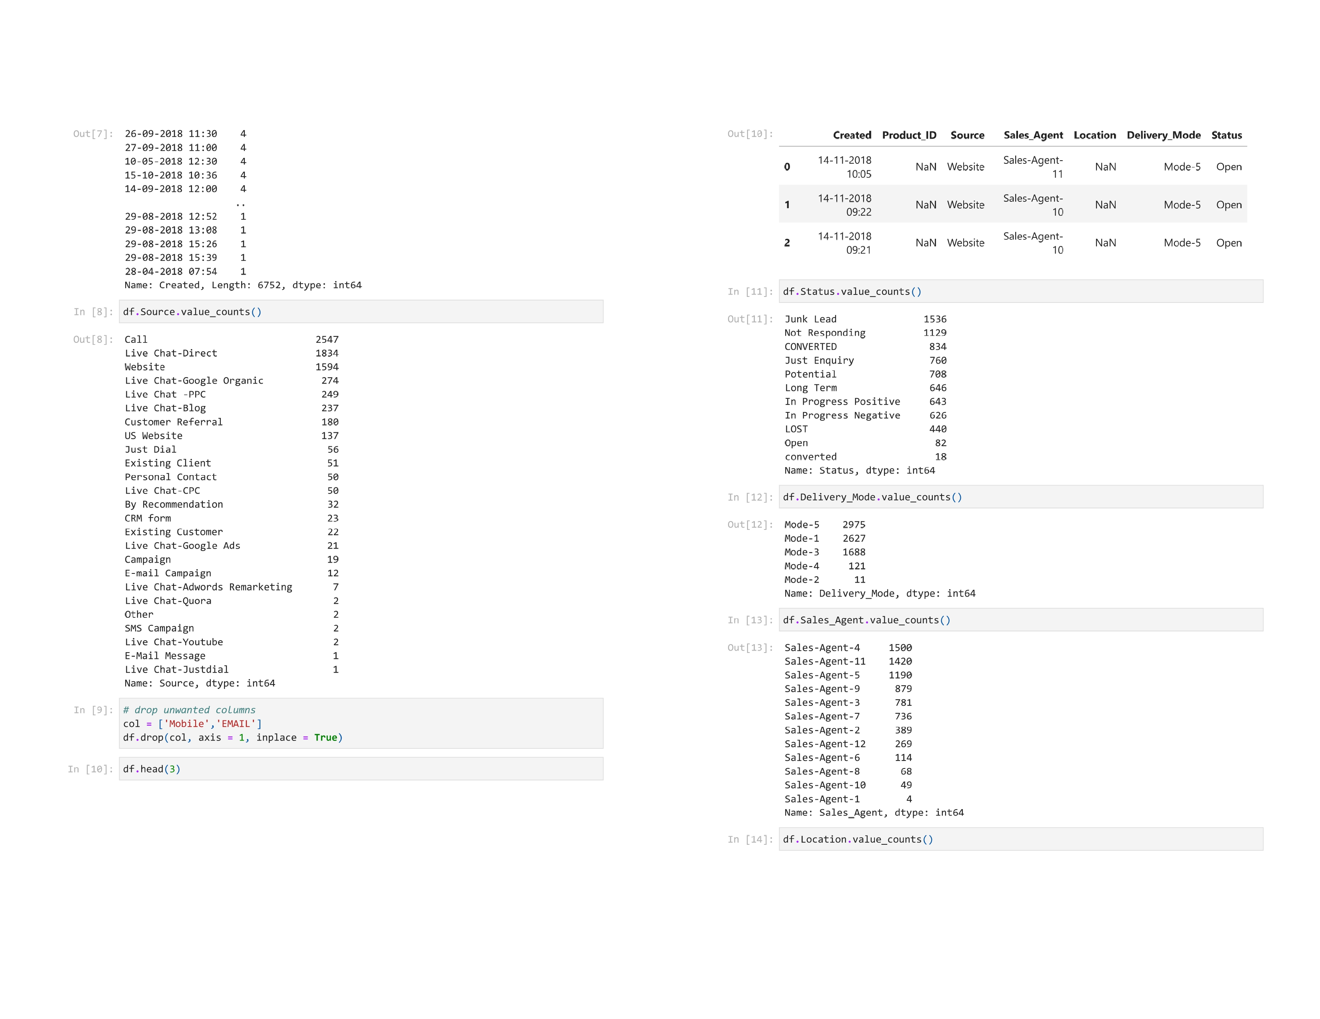

Slide 42
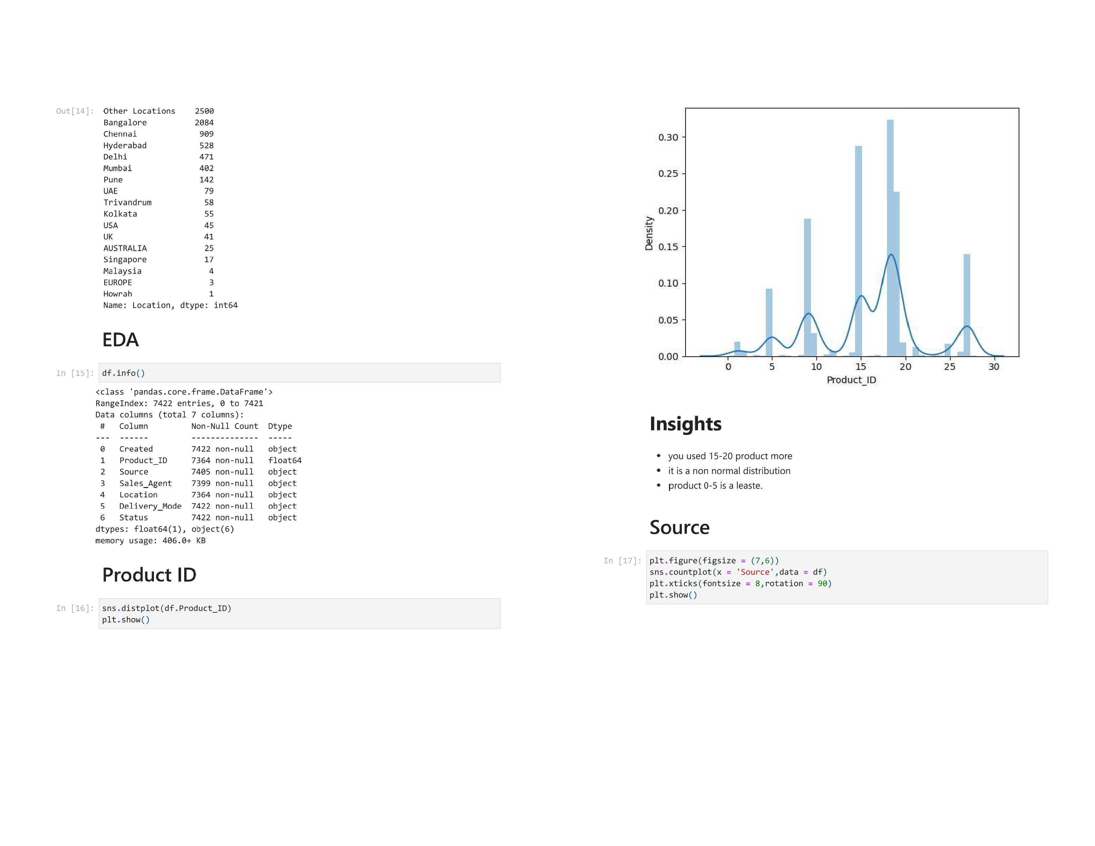

Slide 43
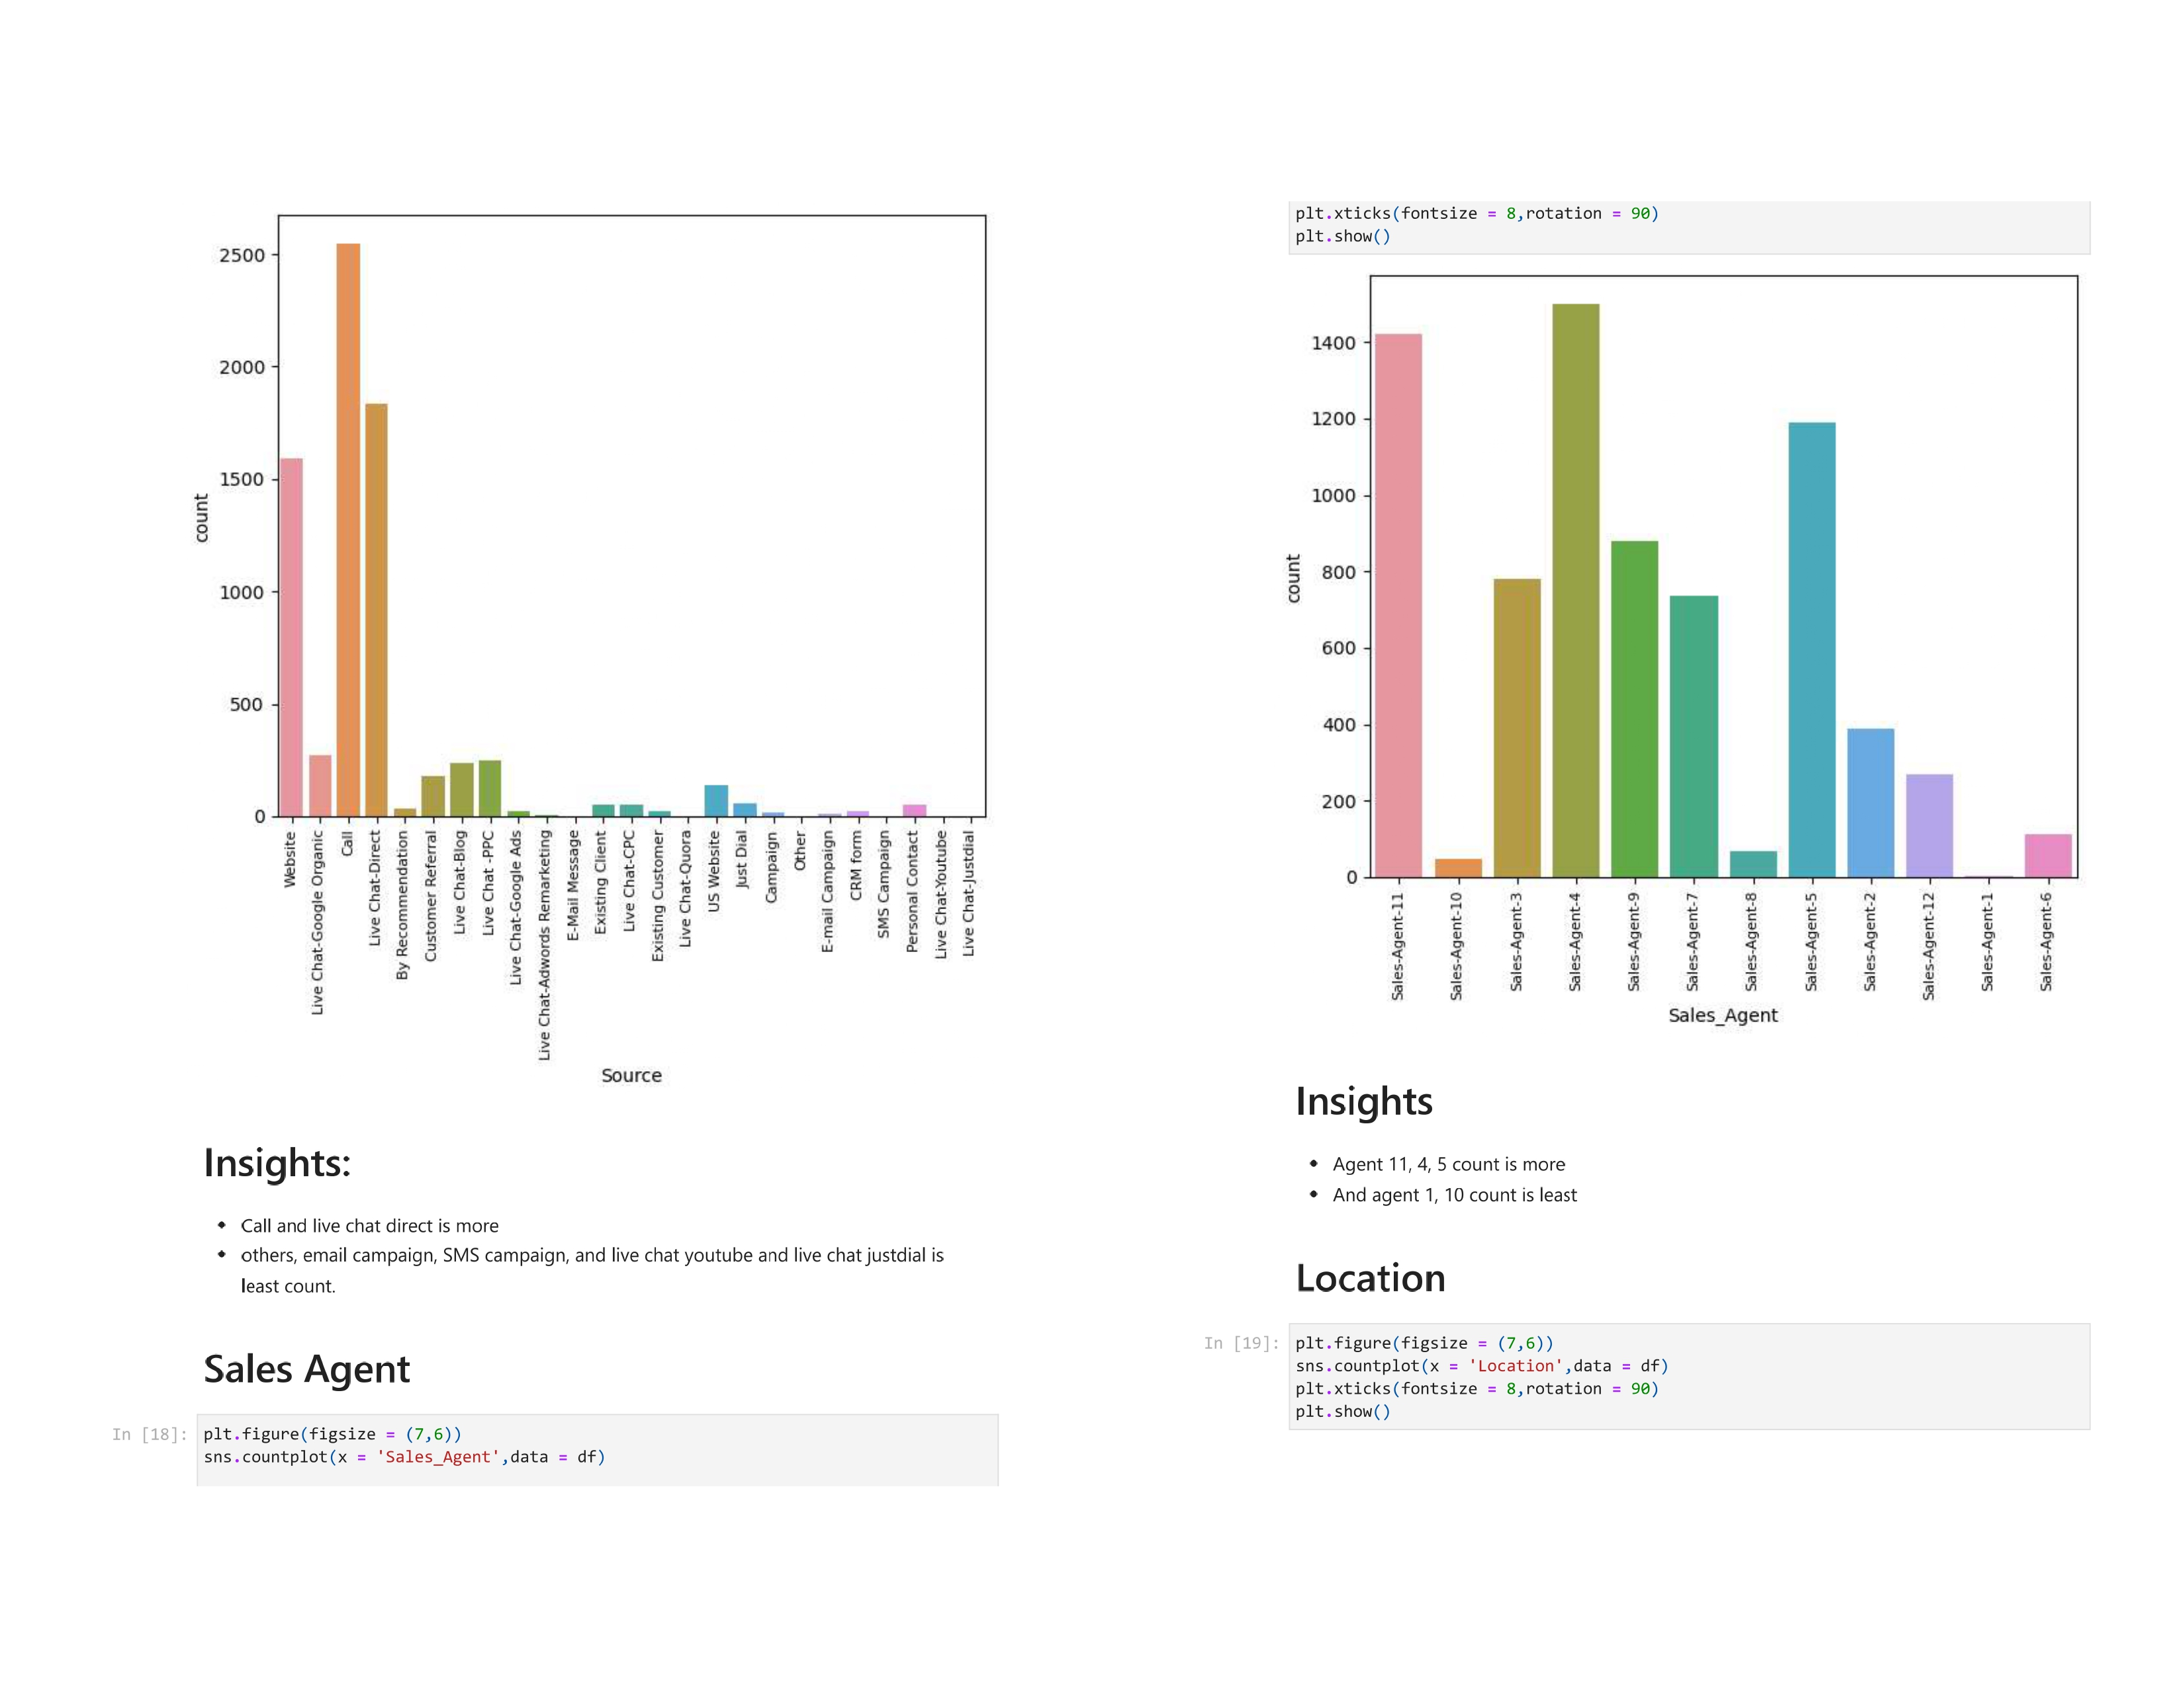

Slide 44
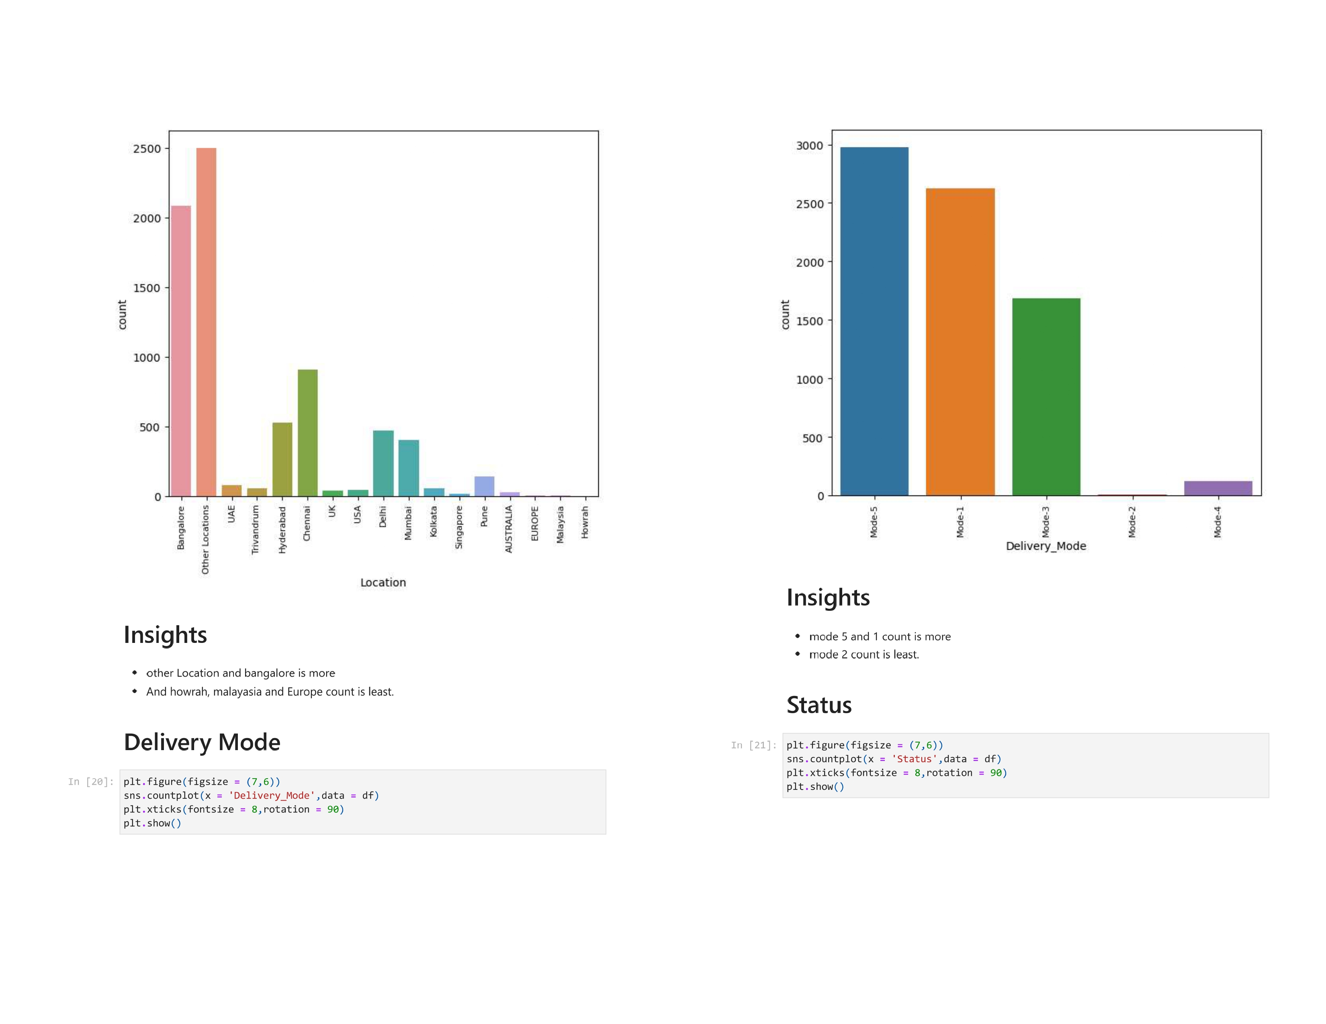

Slide 45
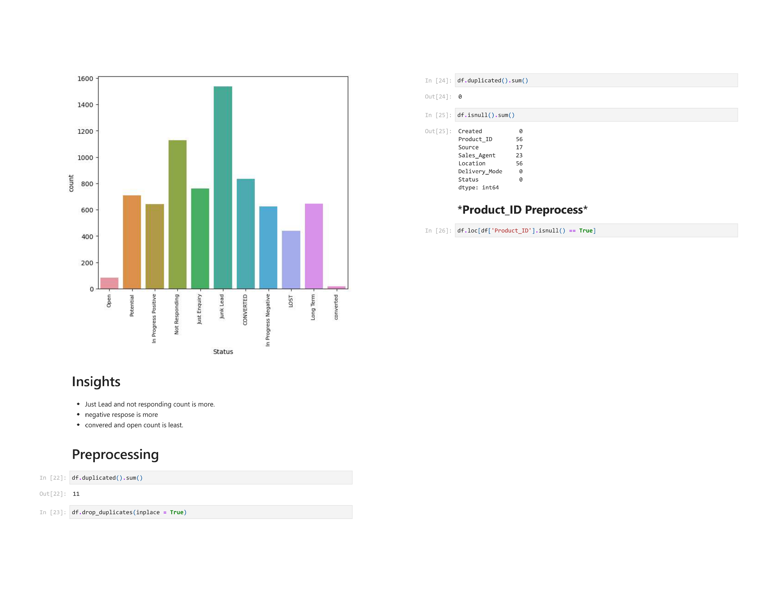

Slide 46
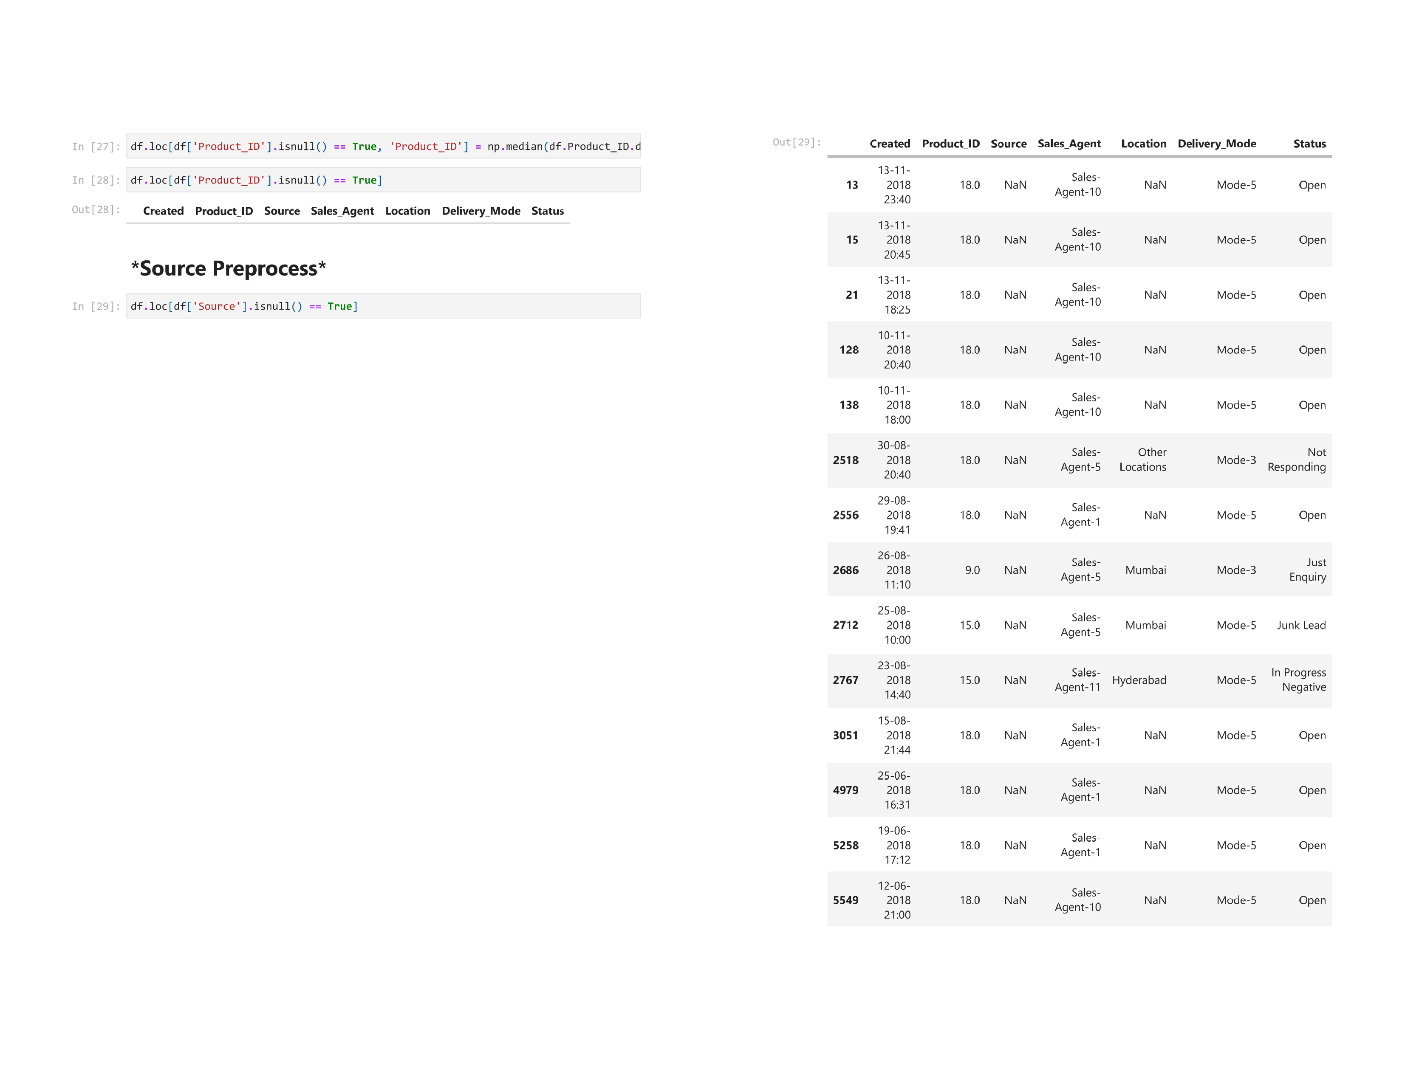

Slide 47
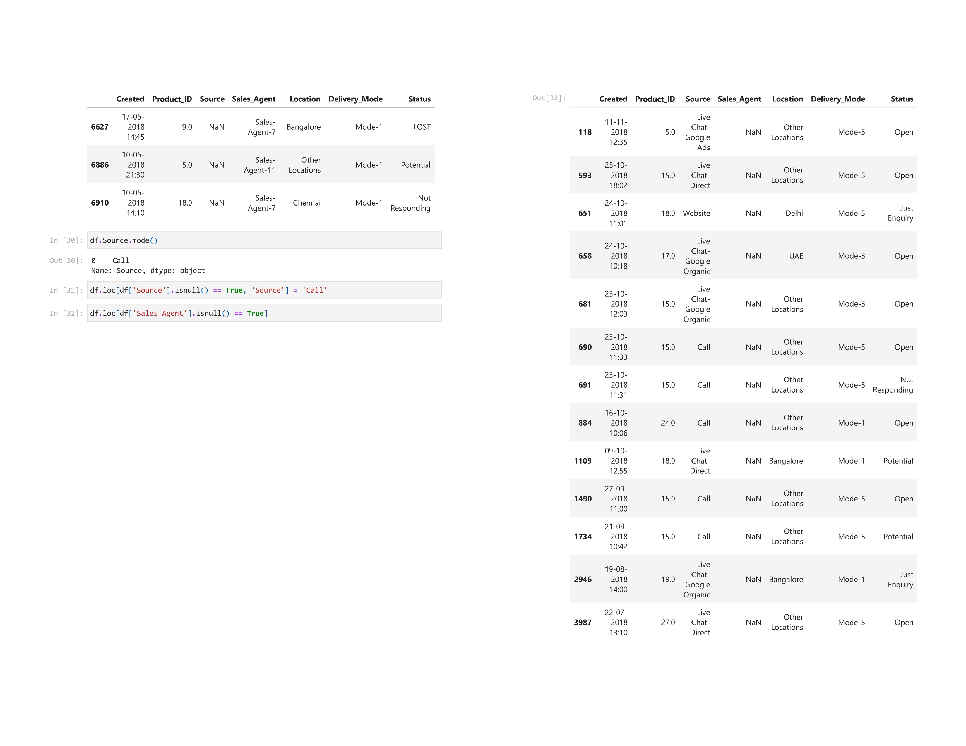

Slide 48
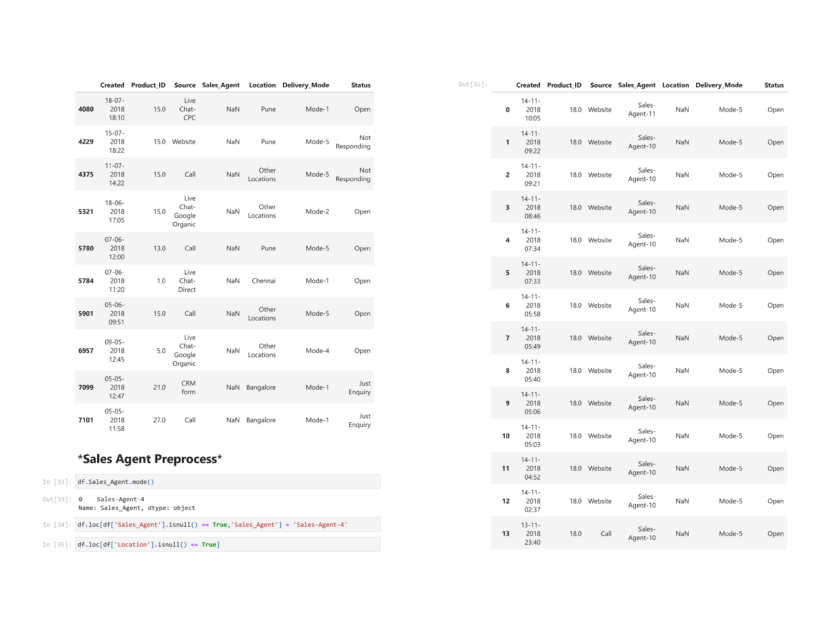

Slide 49
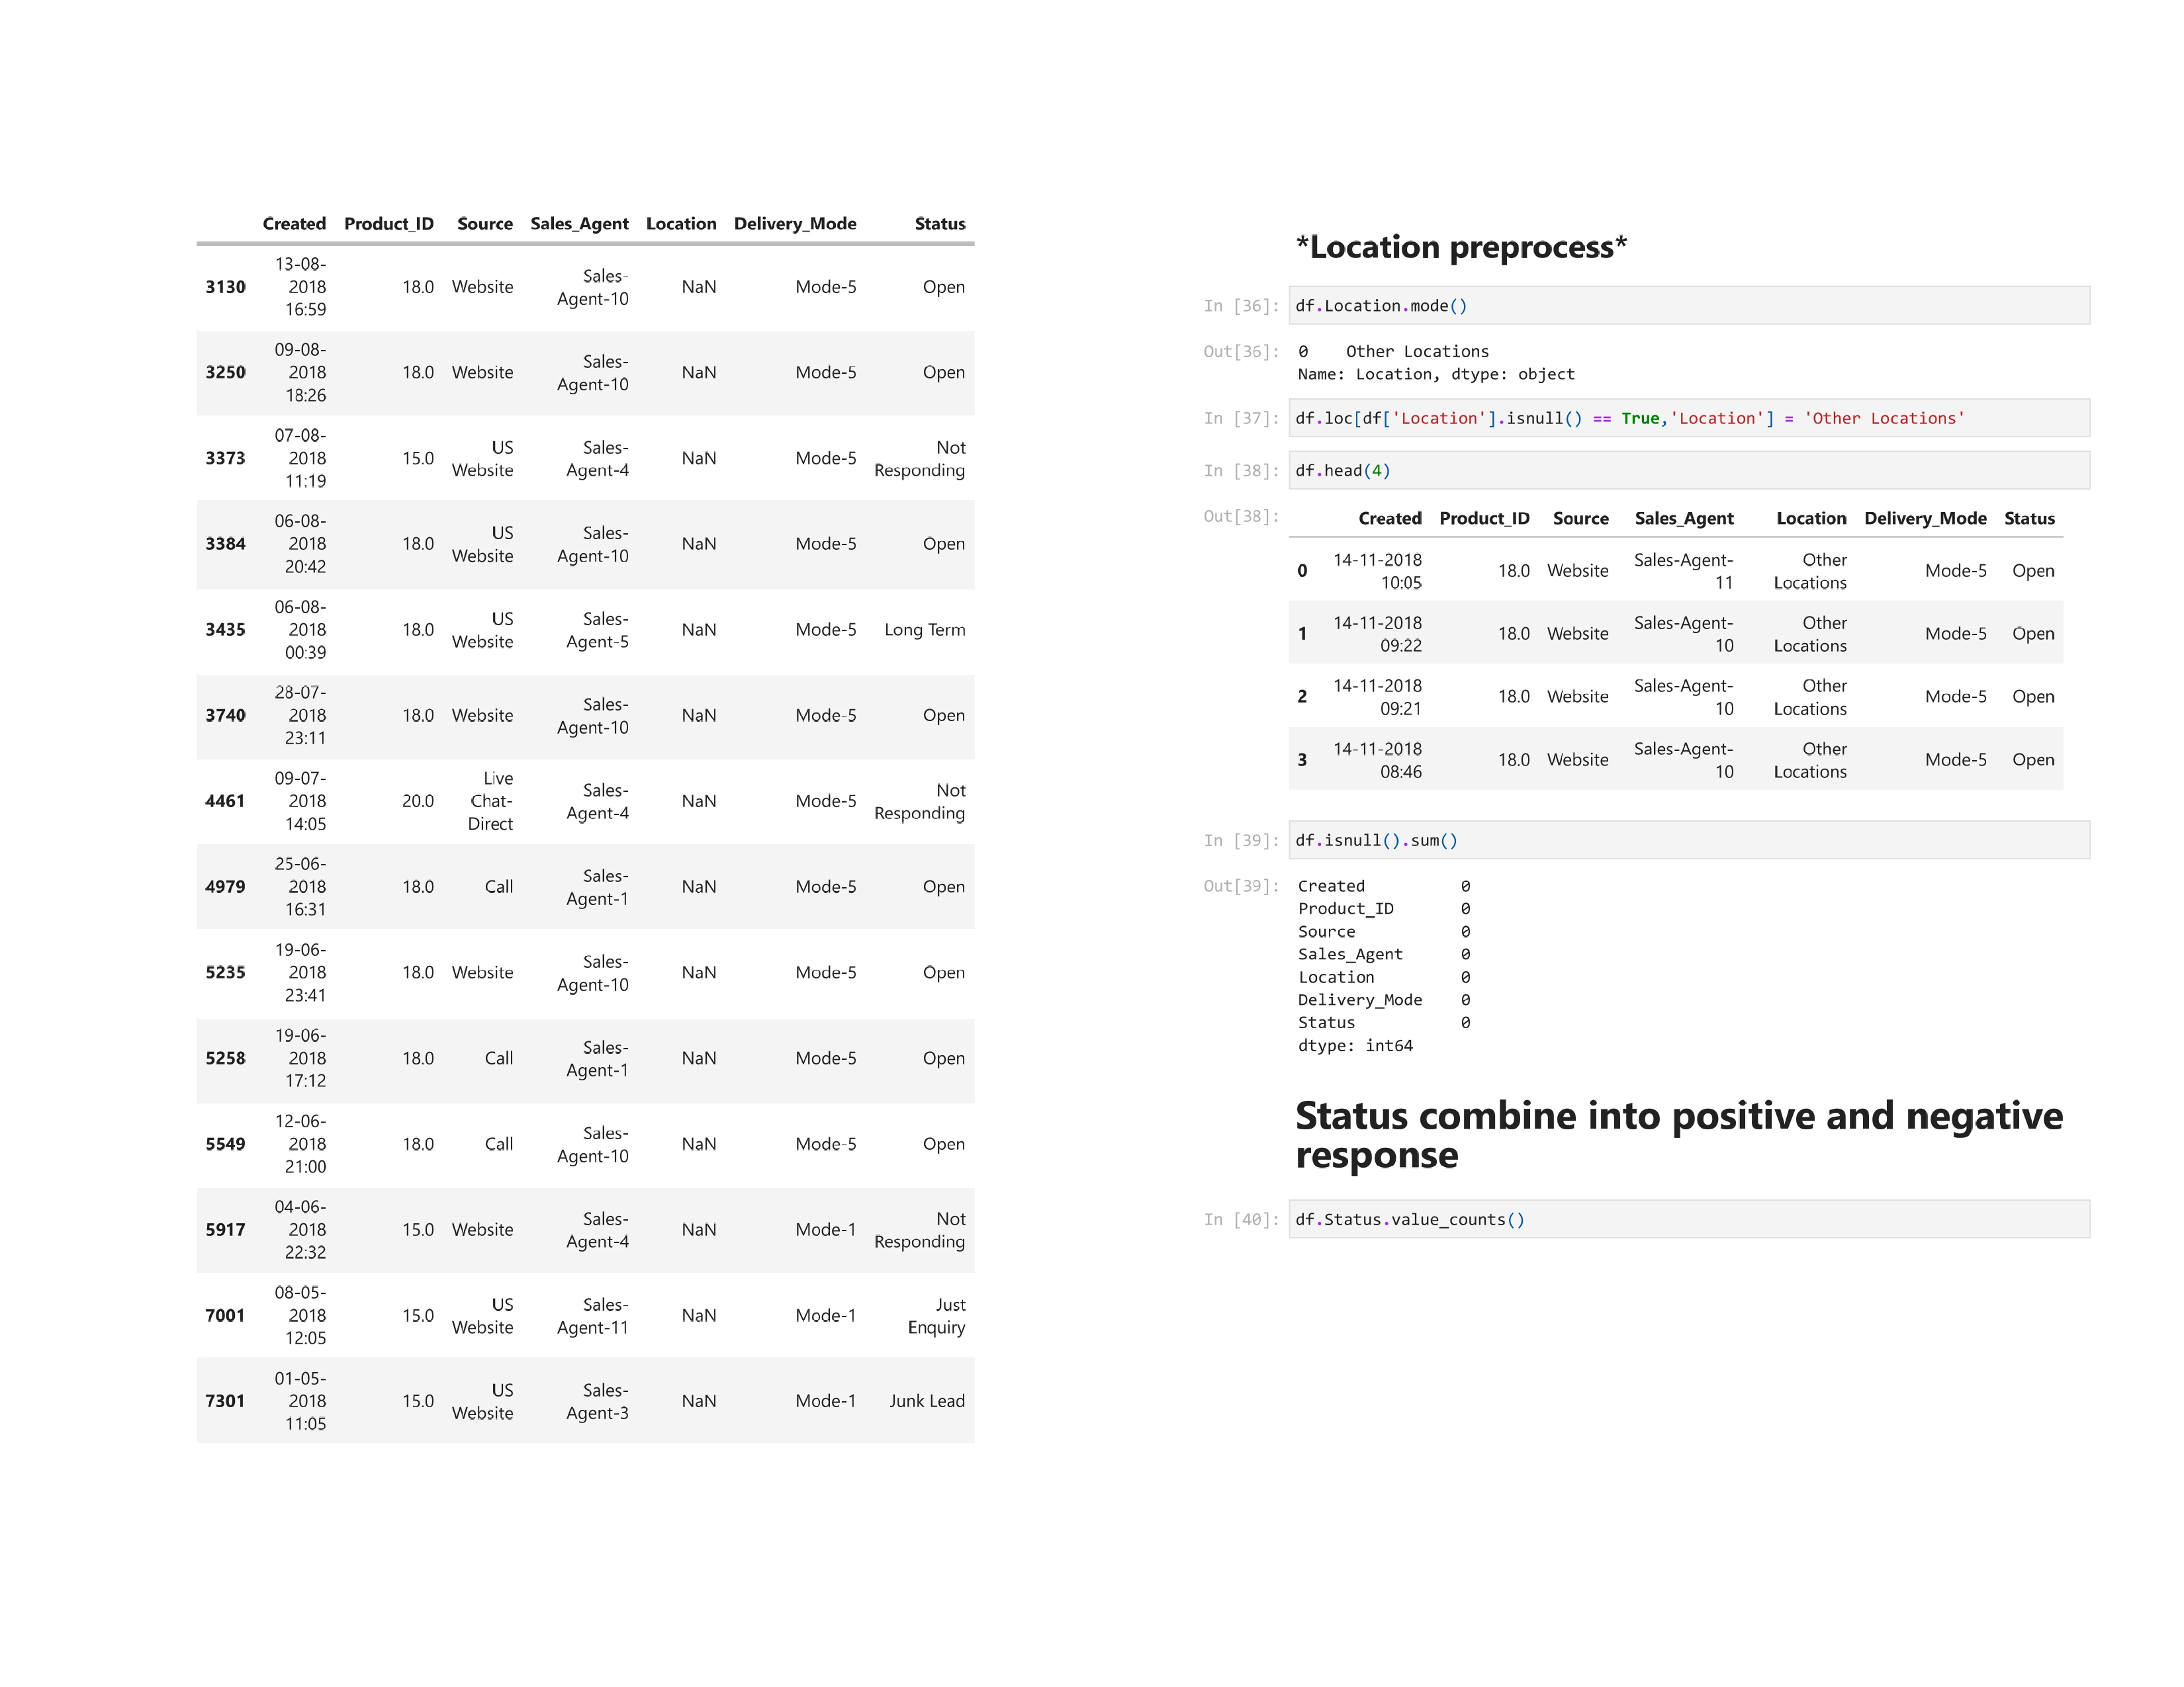

Slide 50
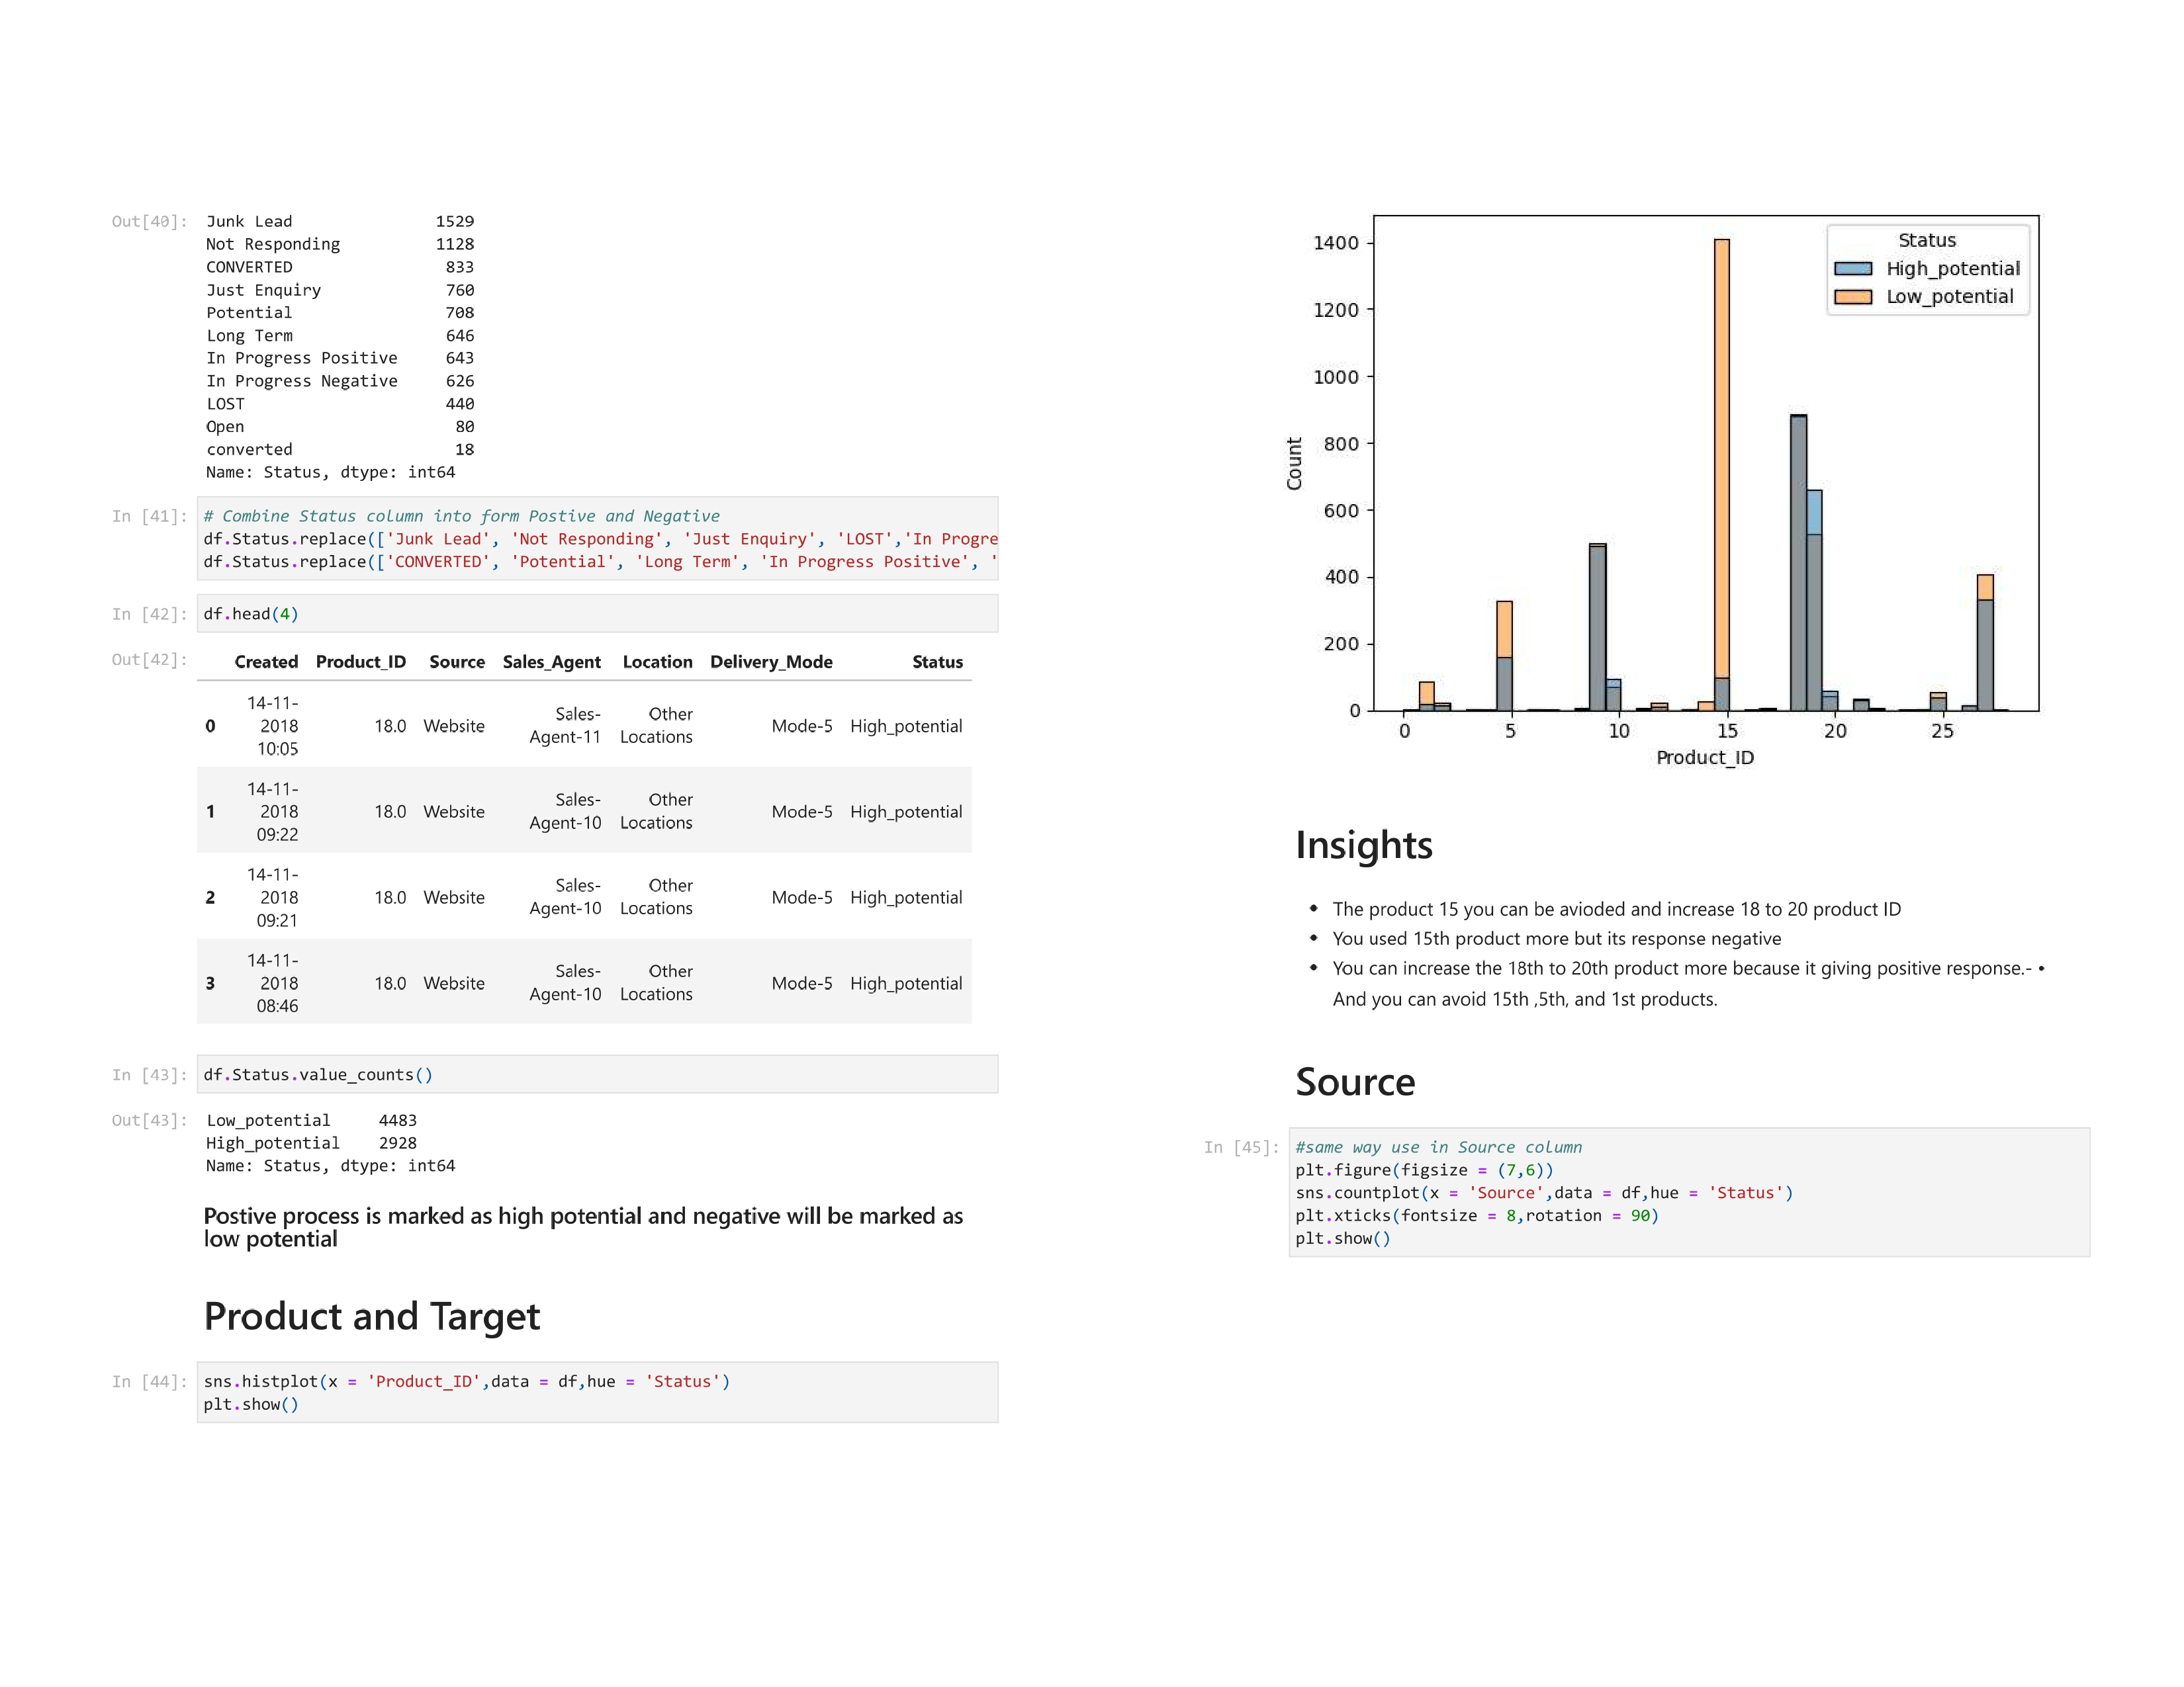

Slide 51
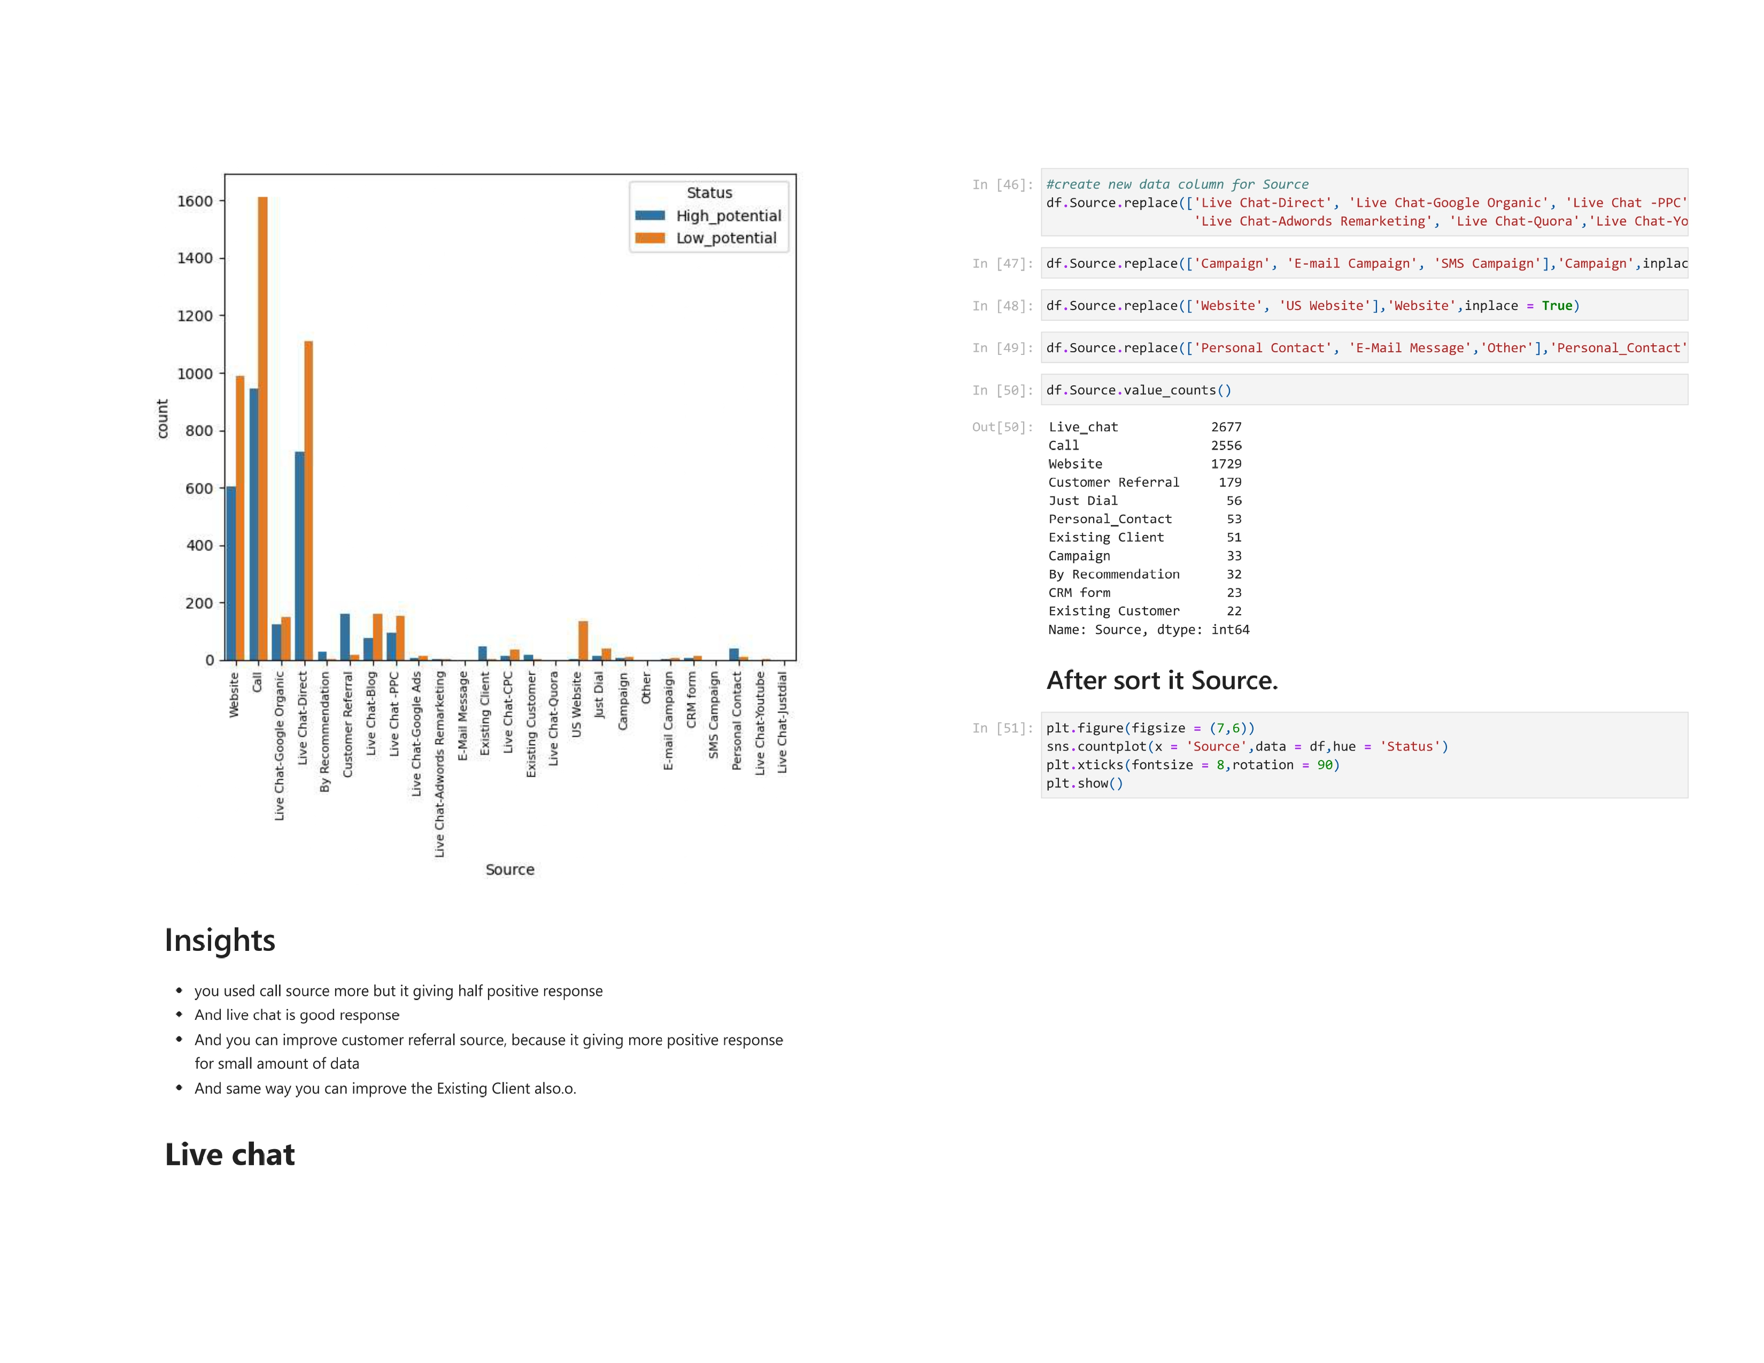

Slide 52
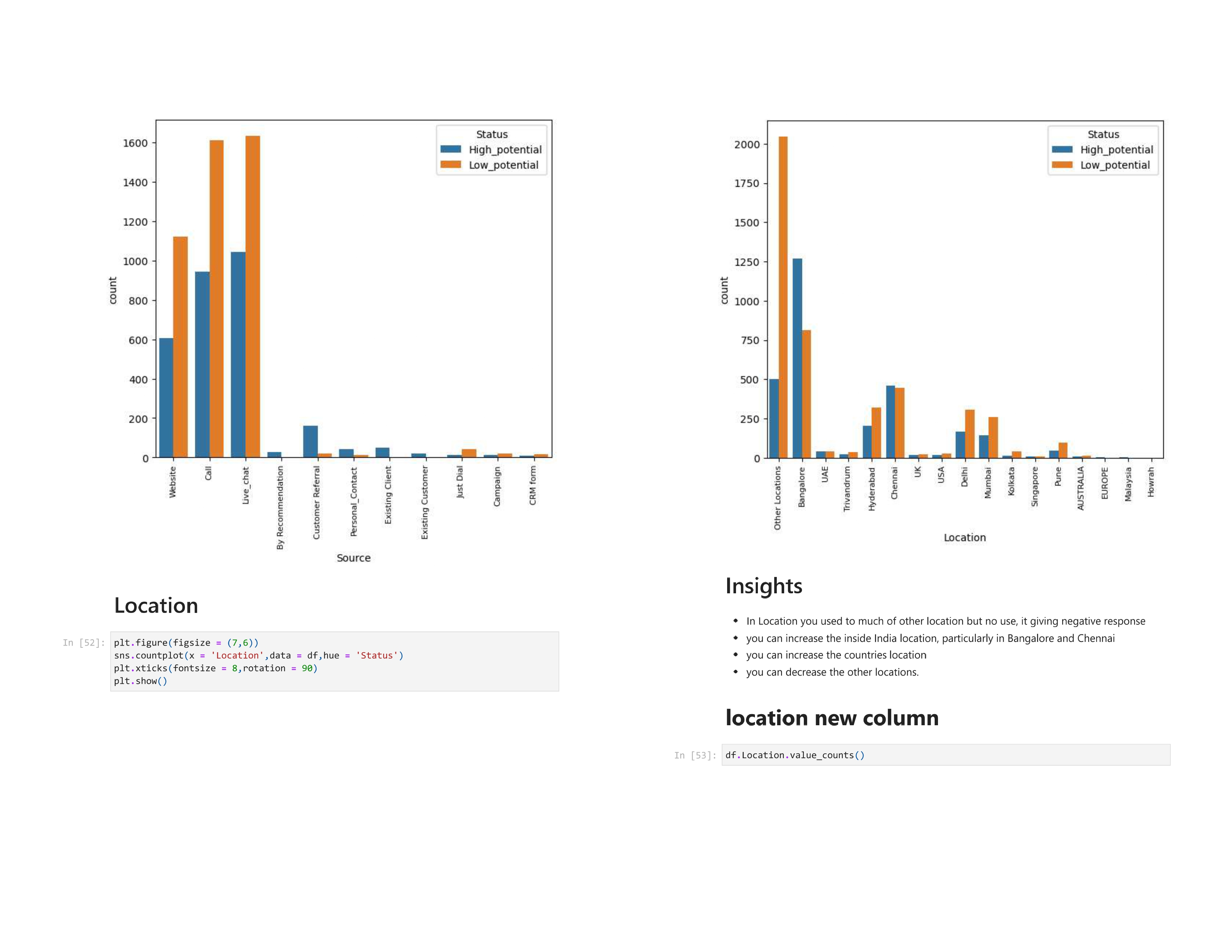

Slide 53
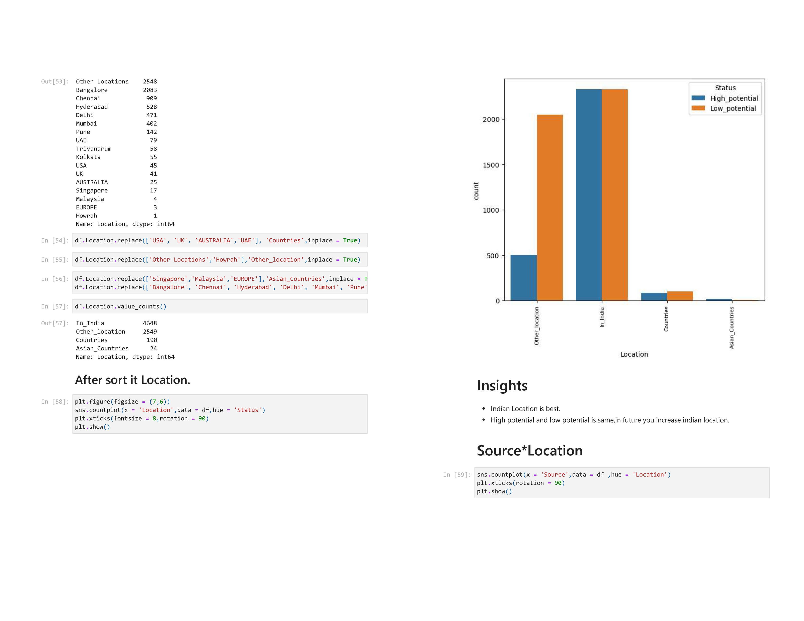

Slide 54
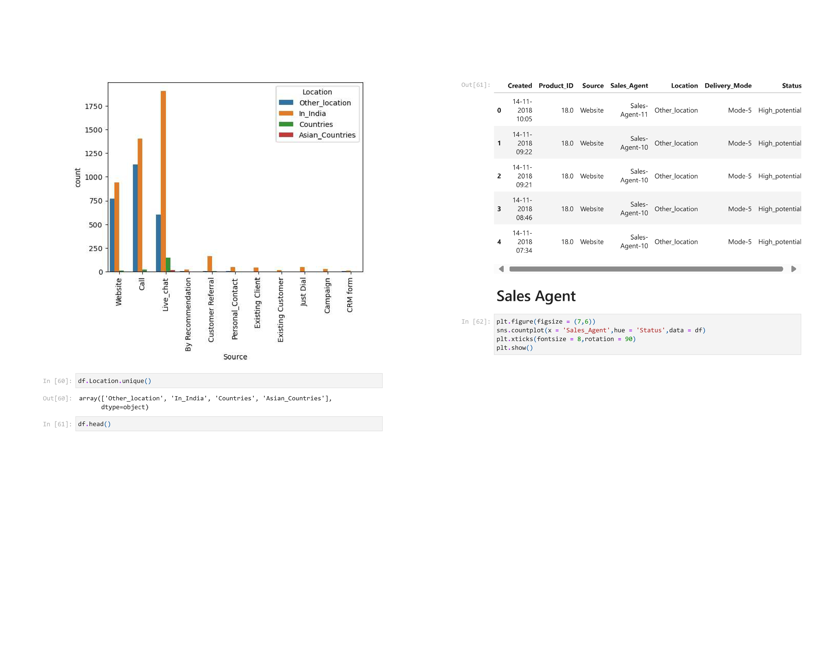

Slide 55
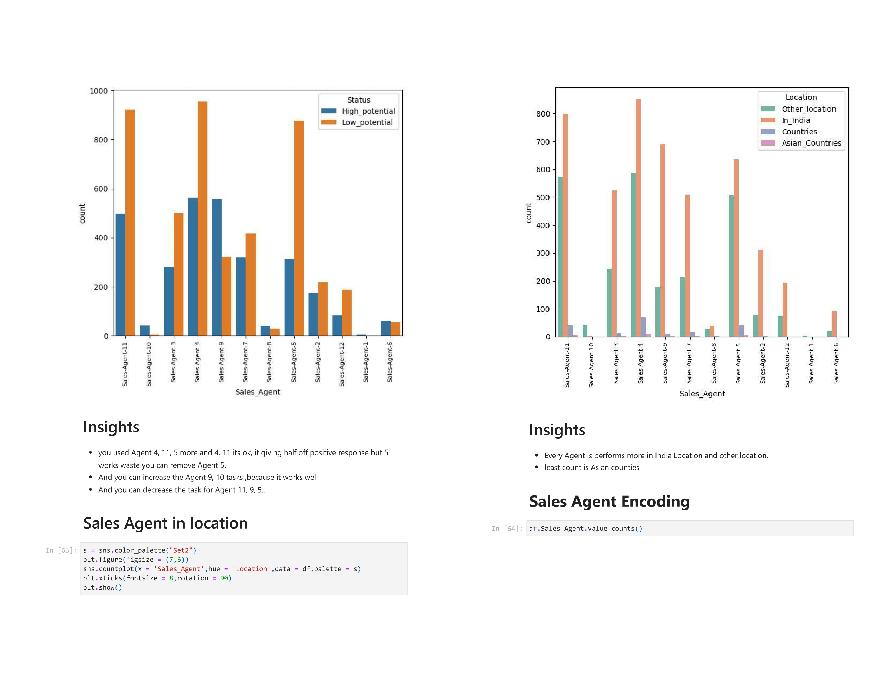

Slide 56
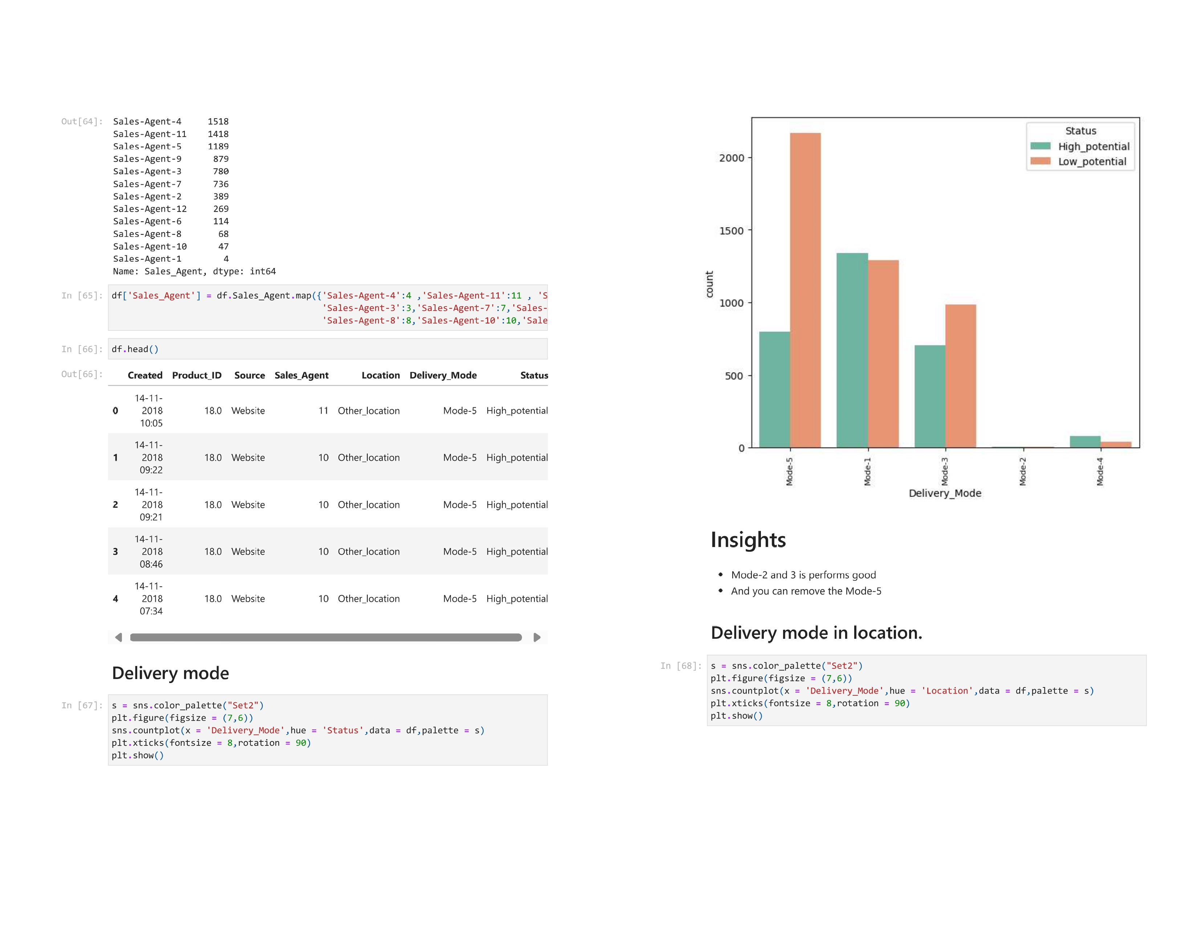

Slide 57
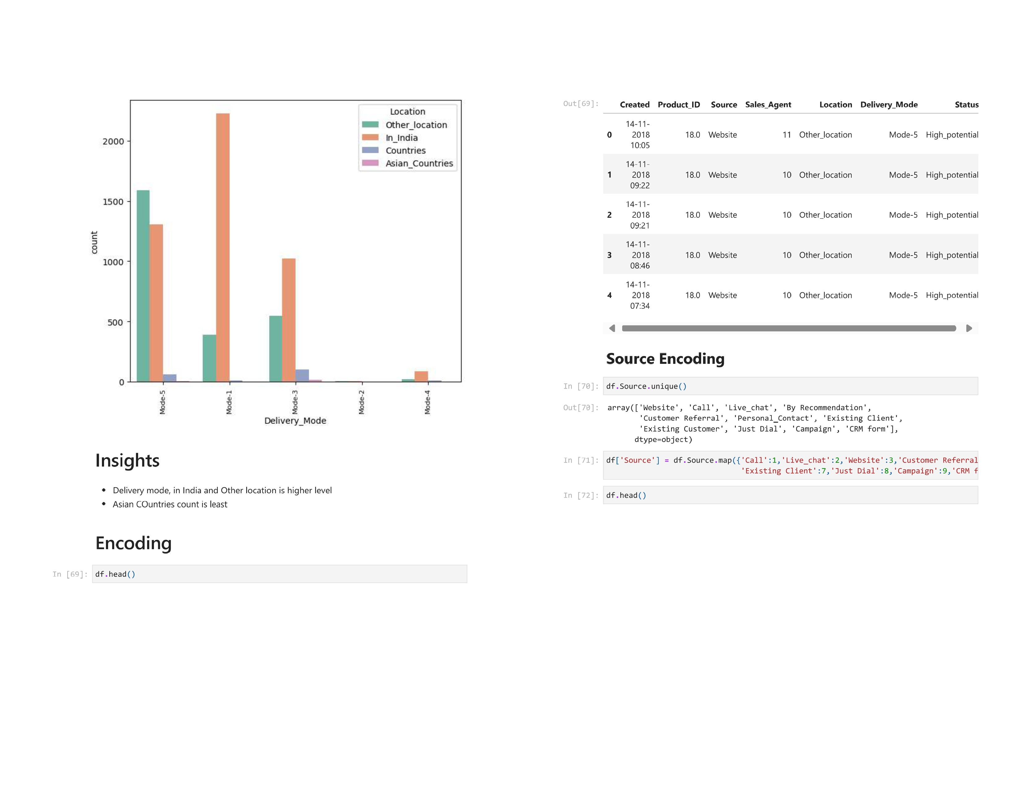

Slide 58
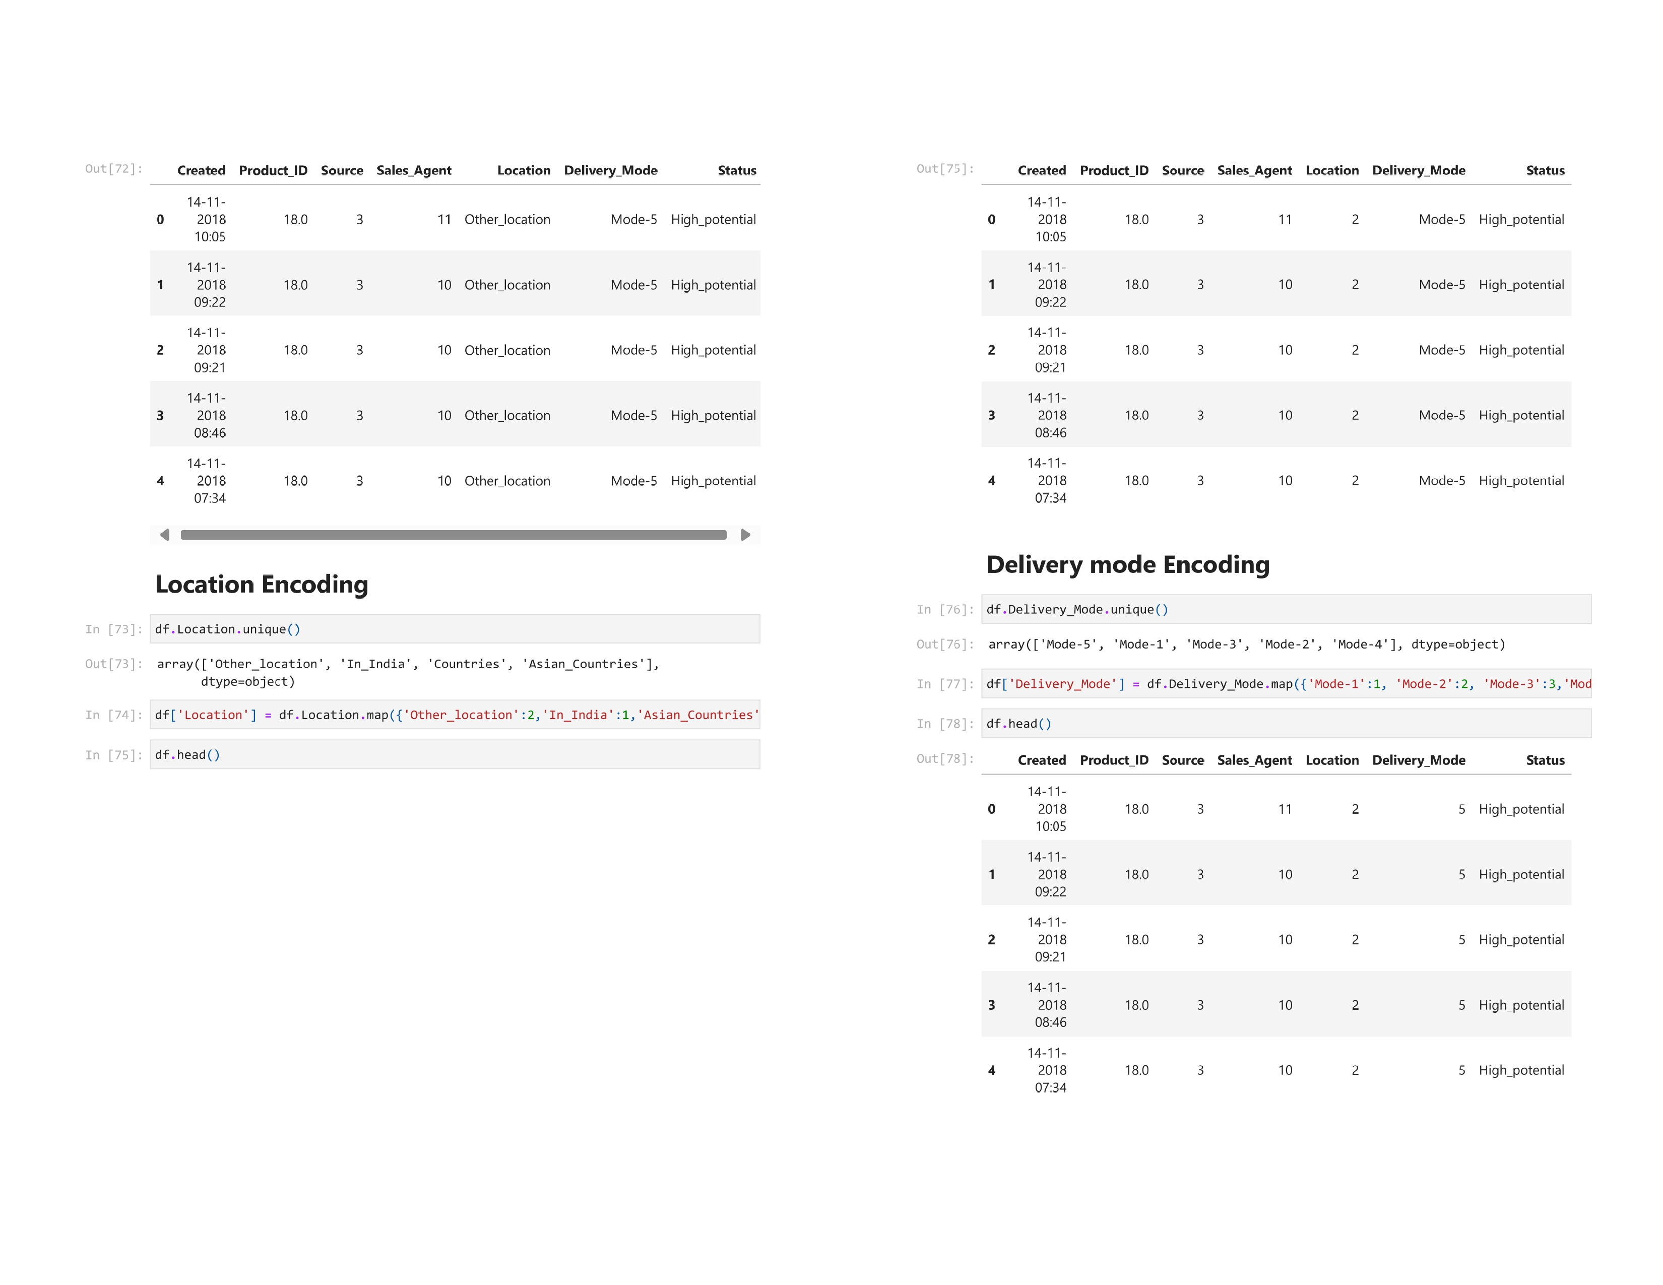

Slide 59
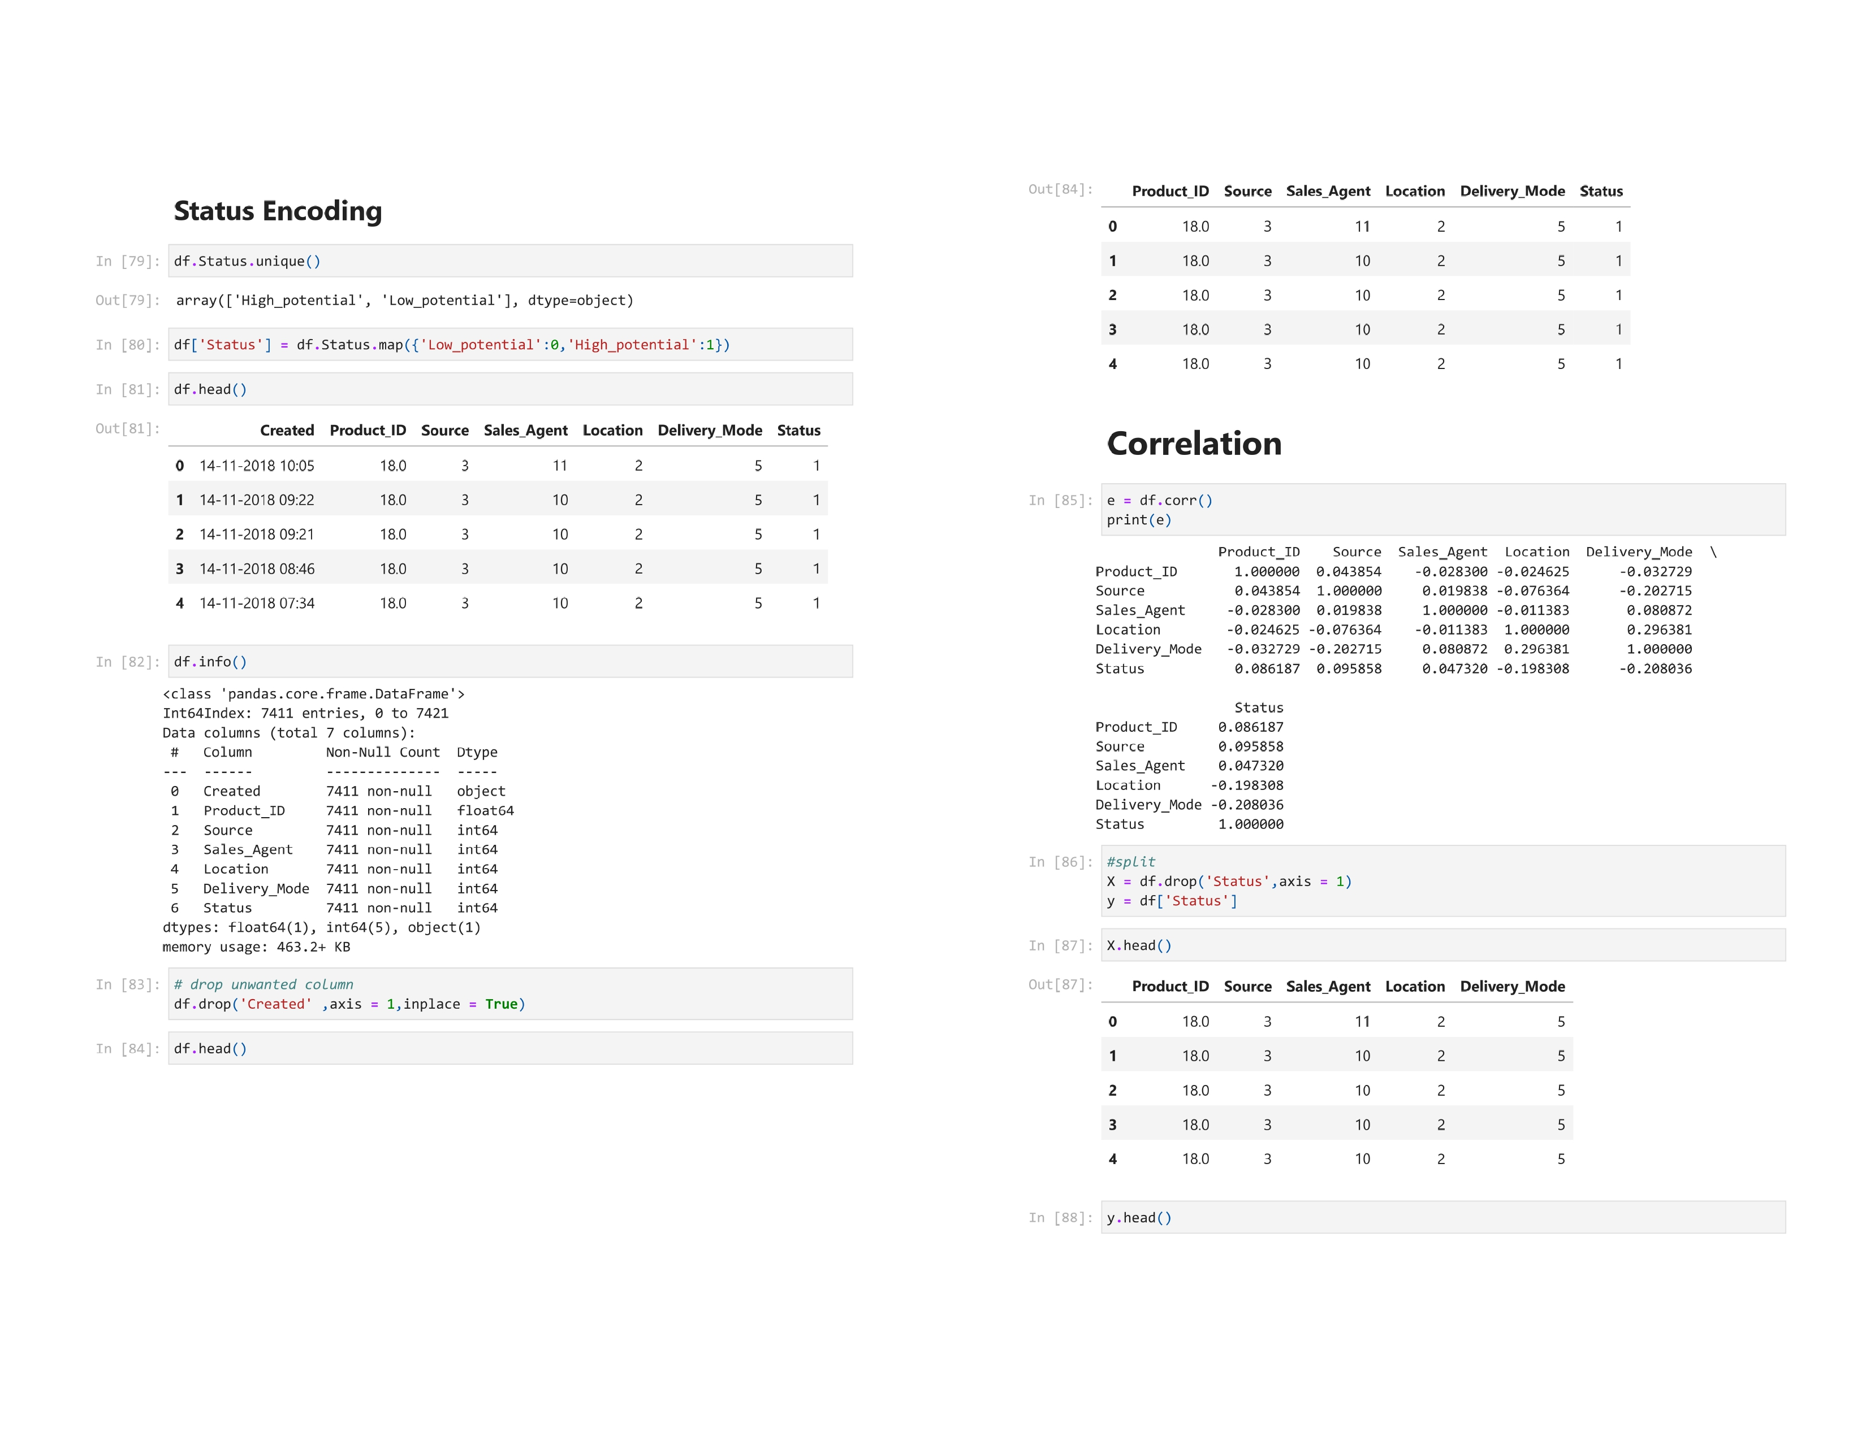

Slide 60
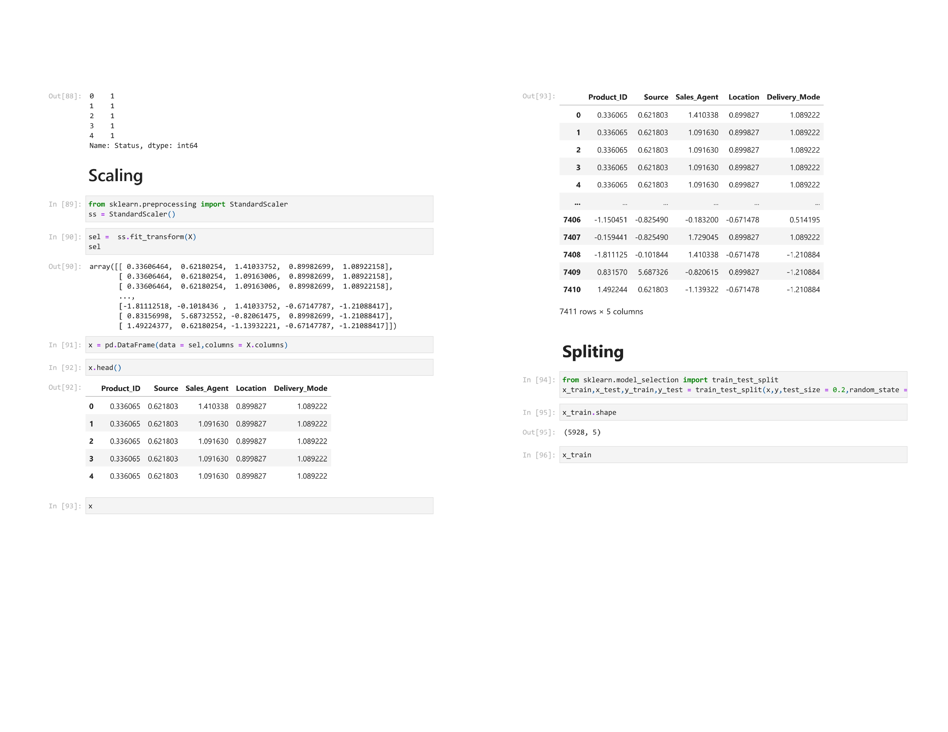

Slide 61
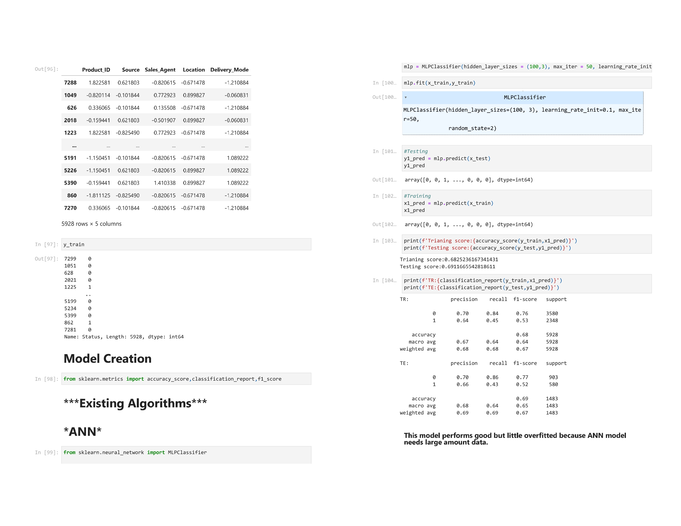

Slide 62
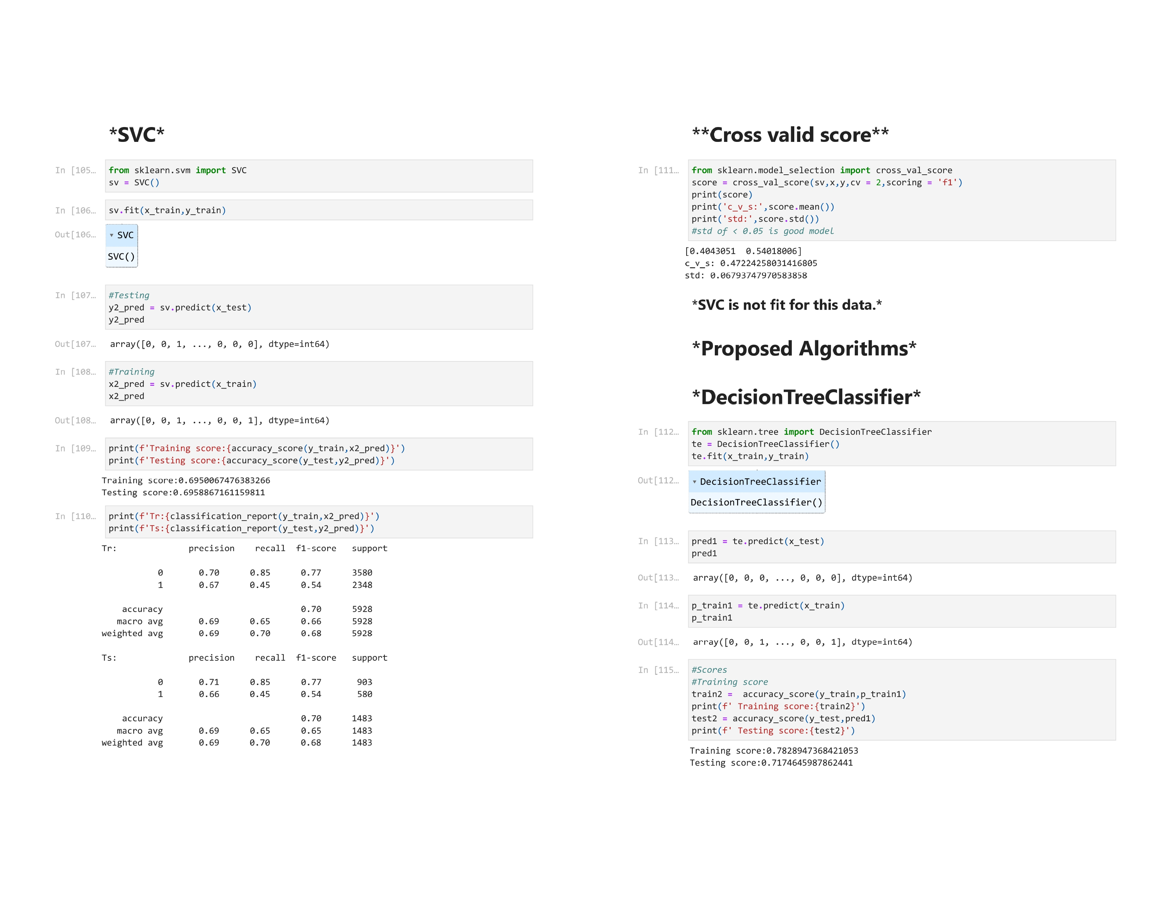

Slide 63
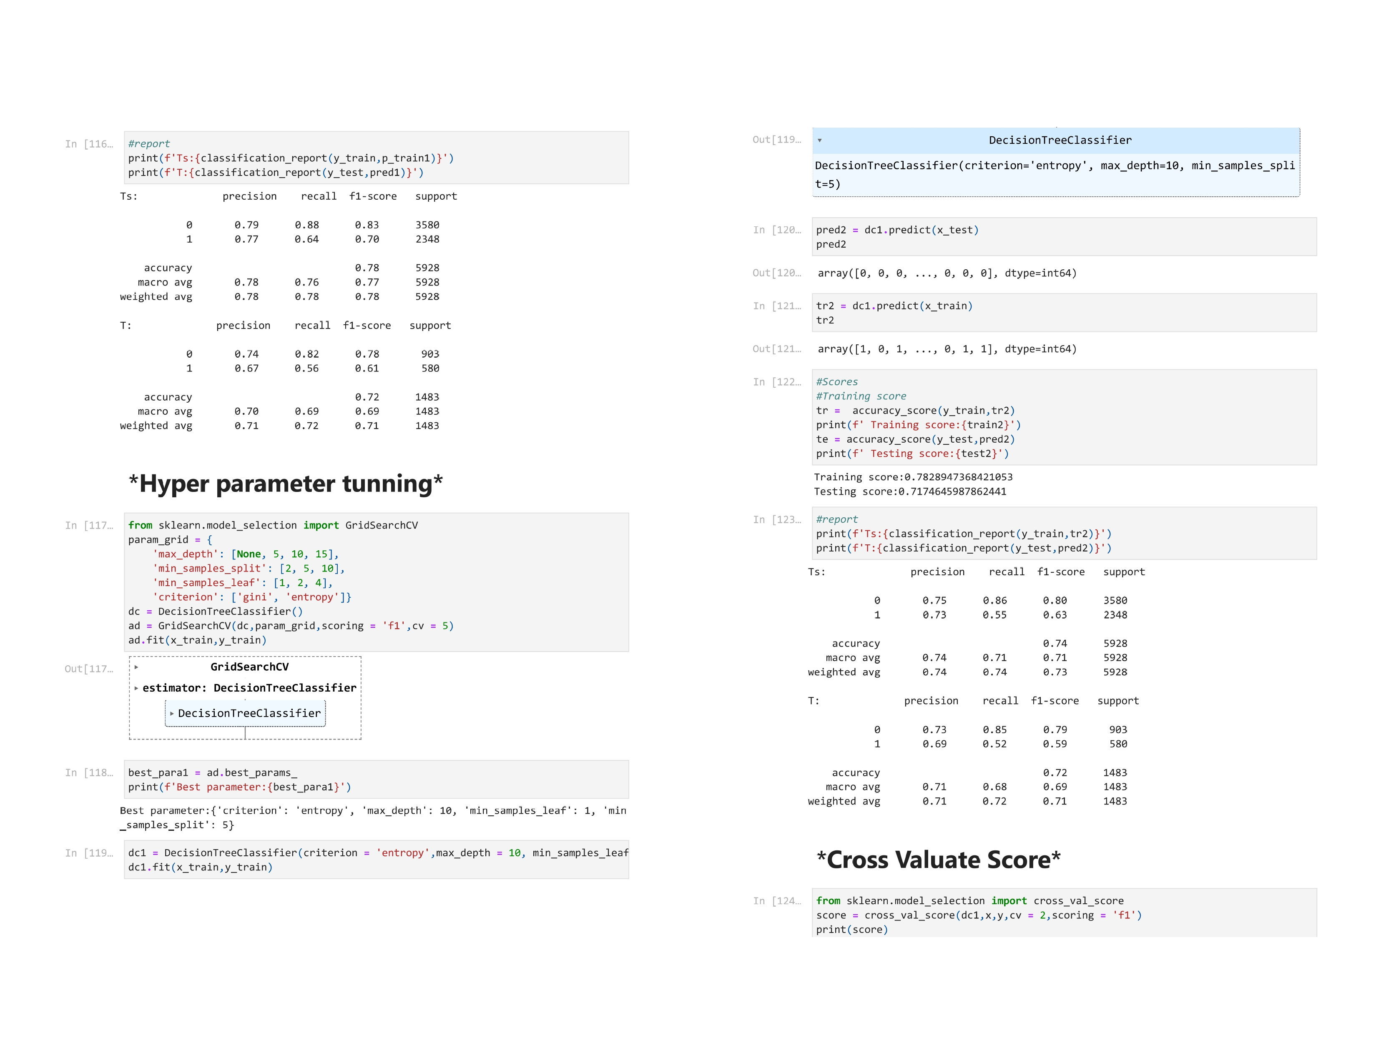

Slide 64
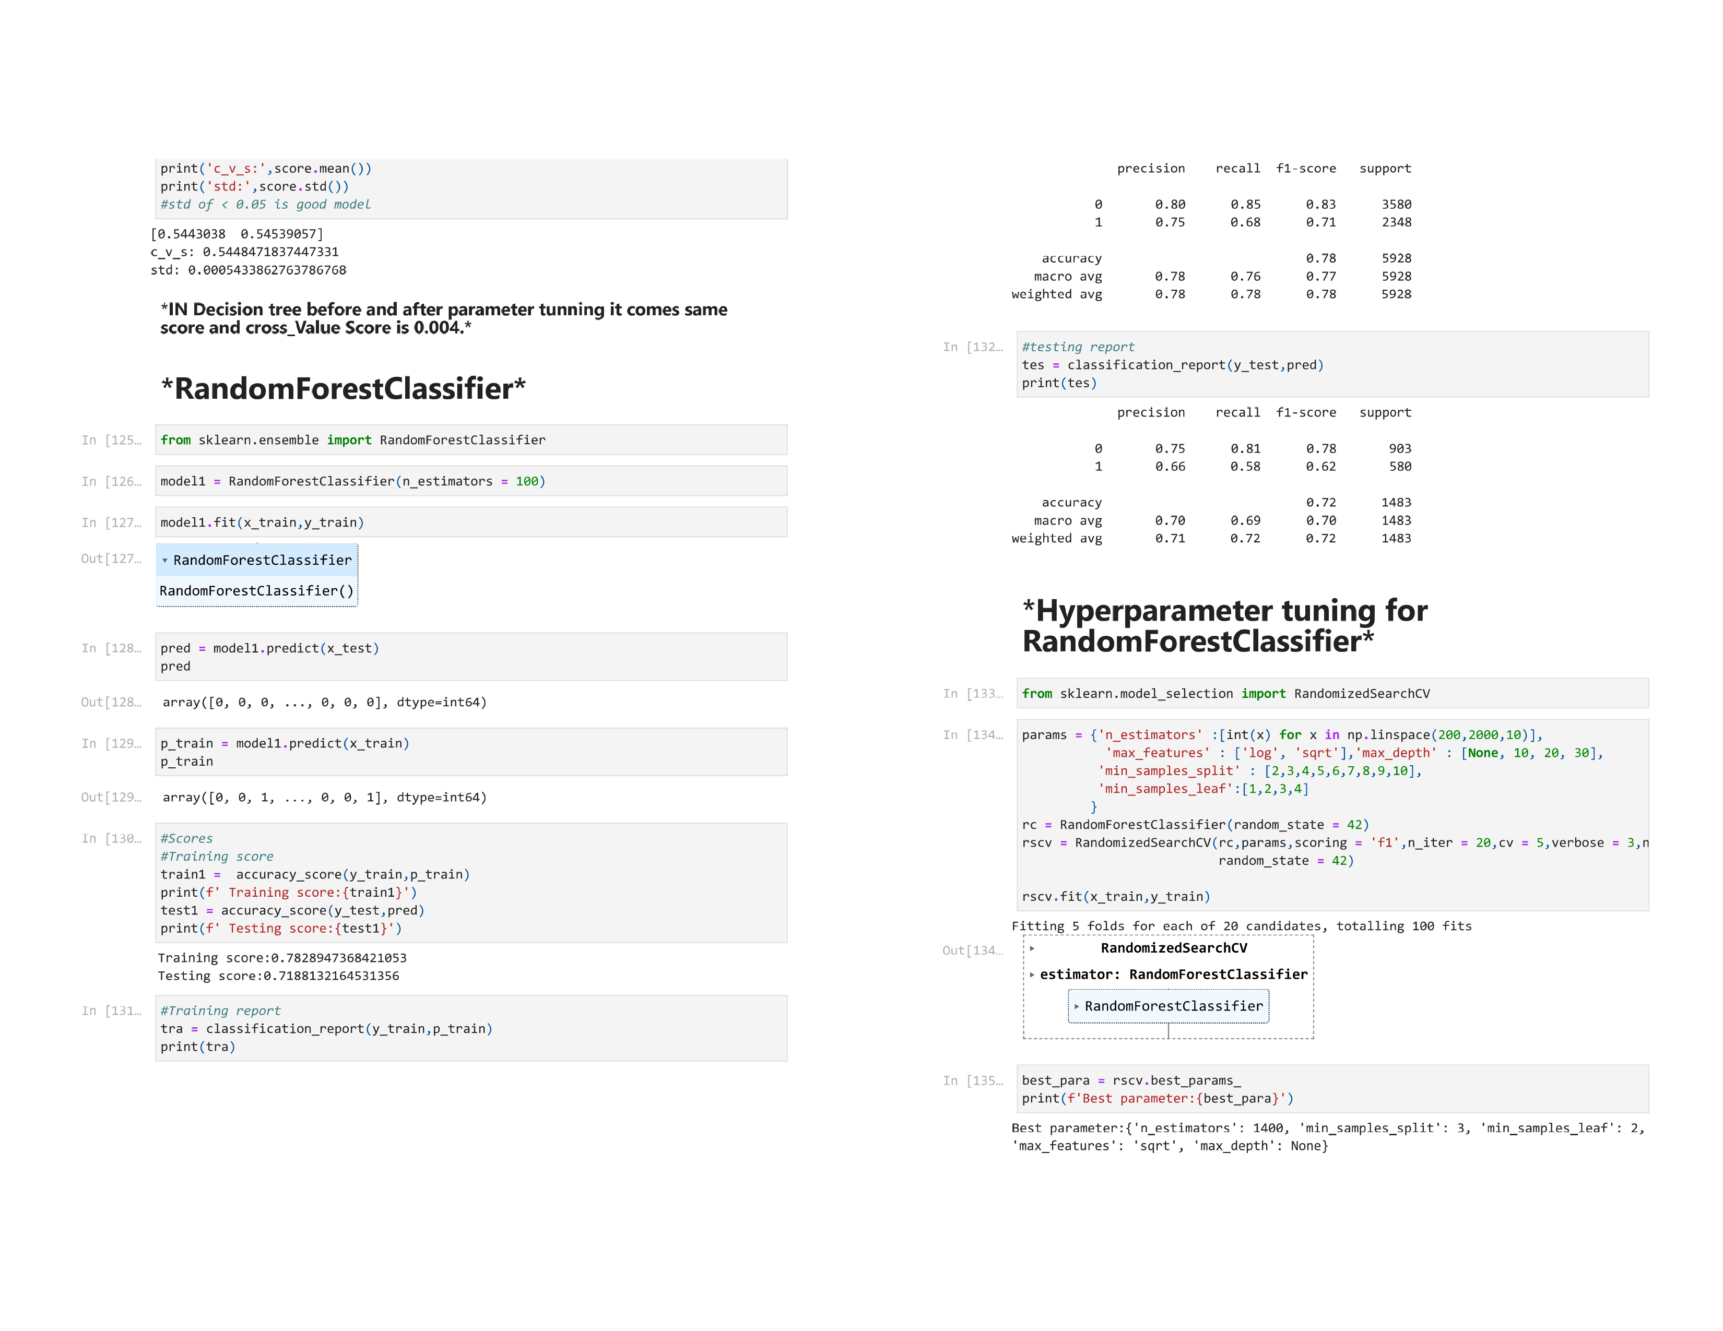

Slide 65
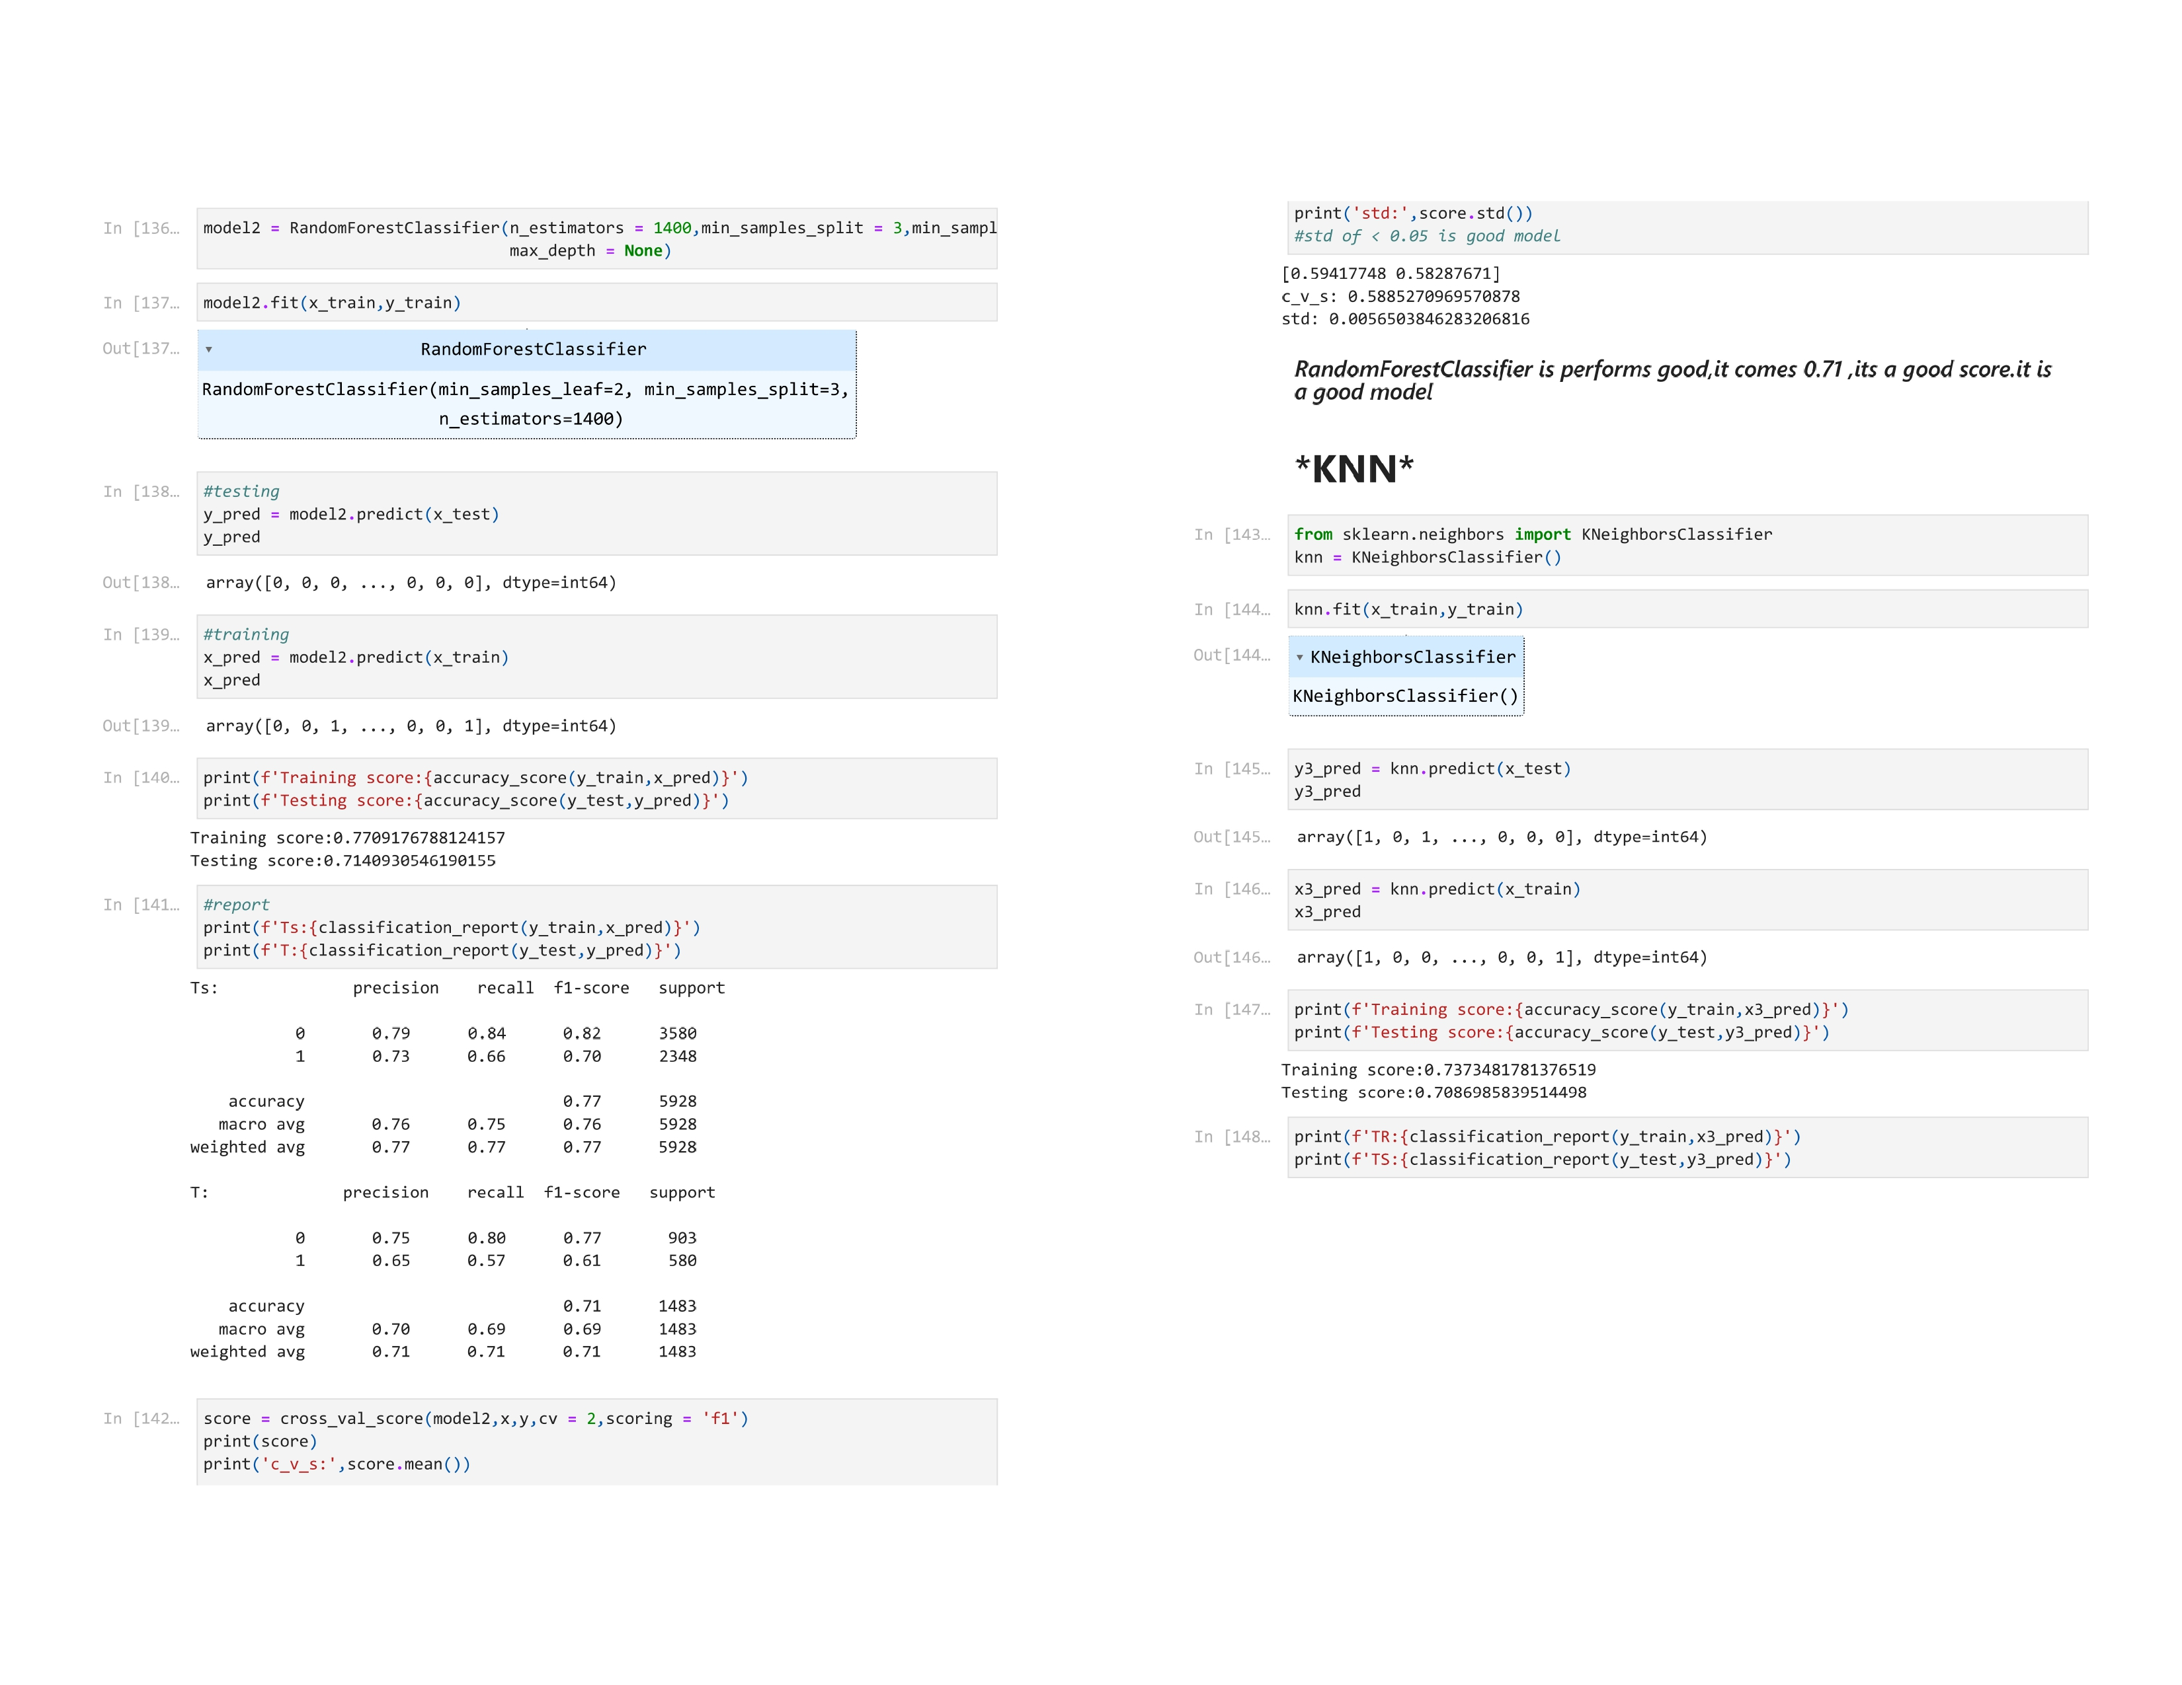

Slide 66
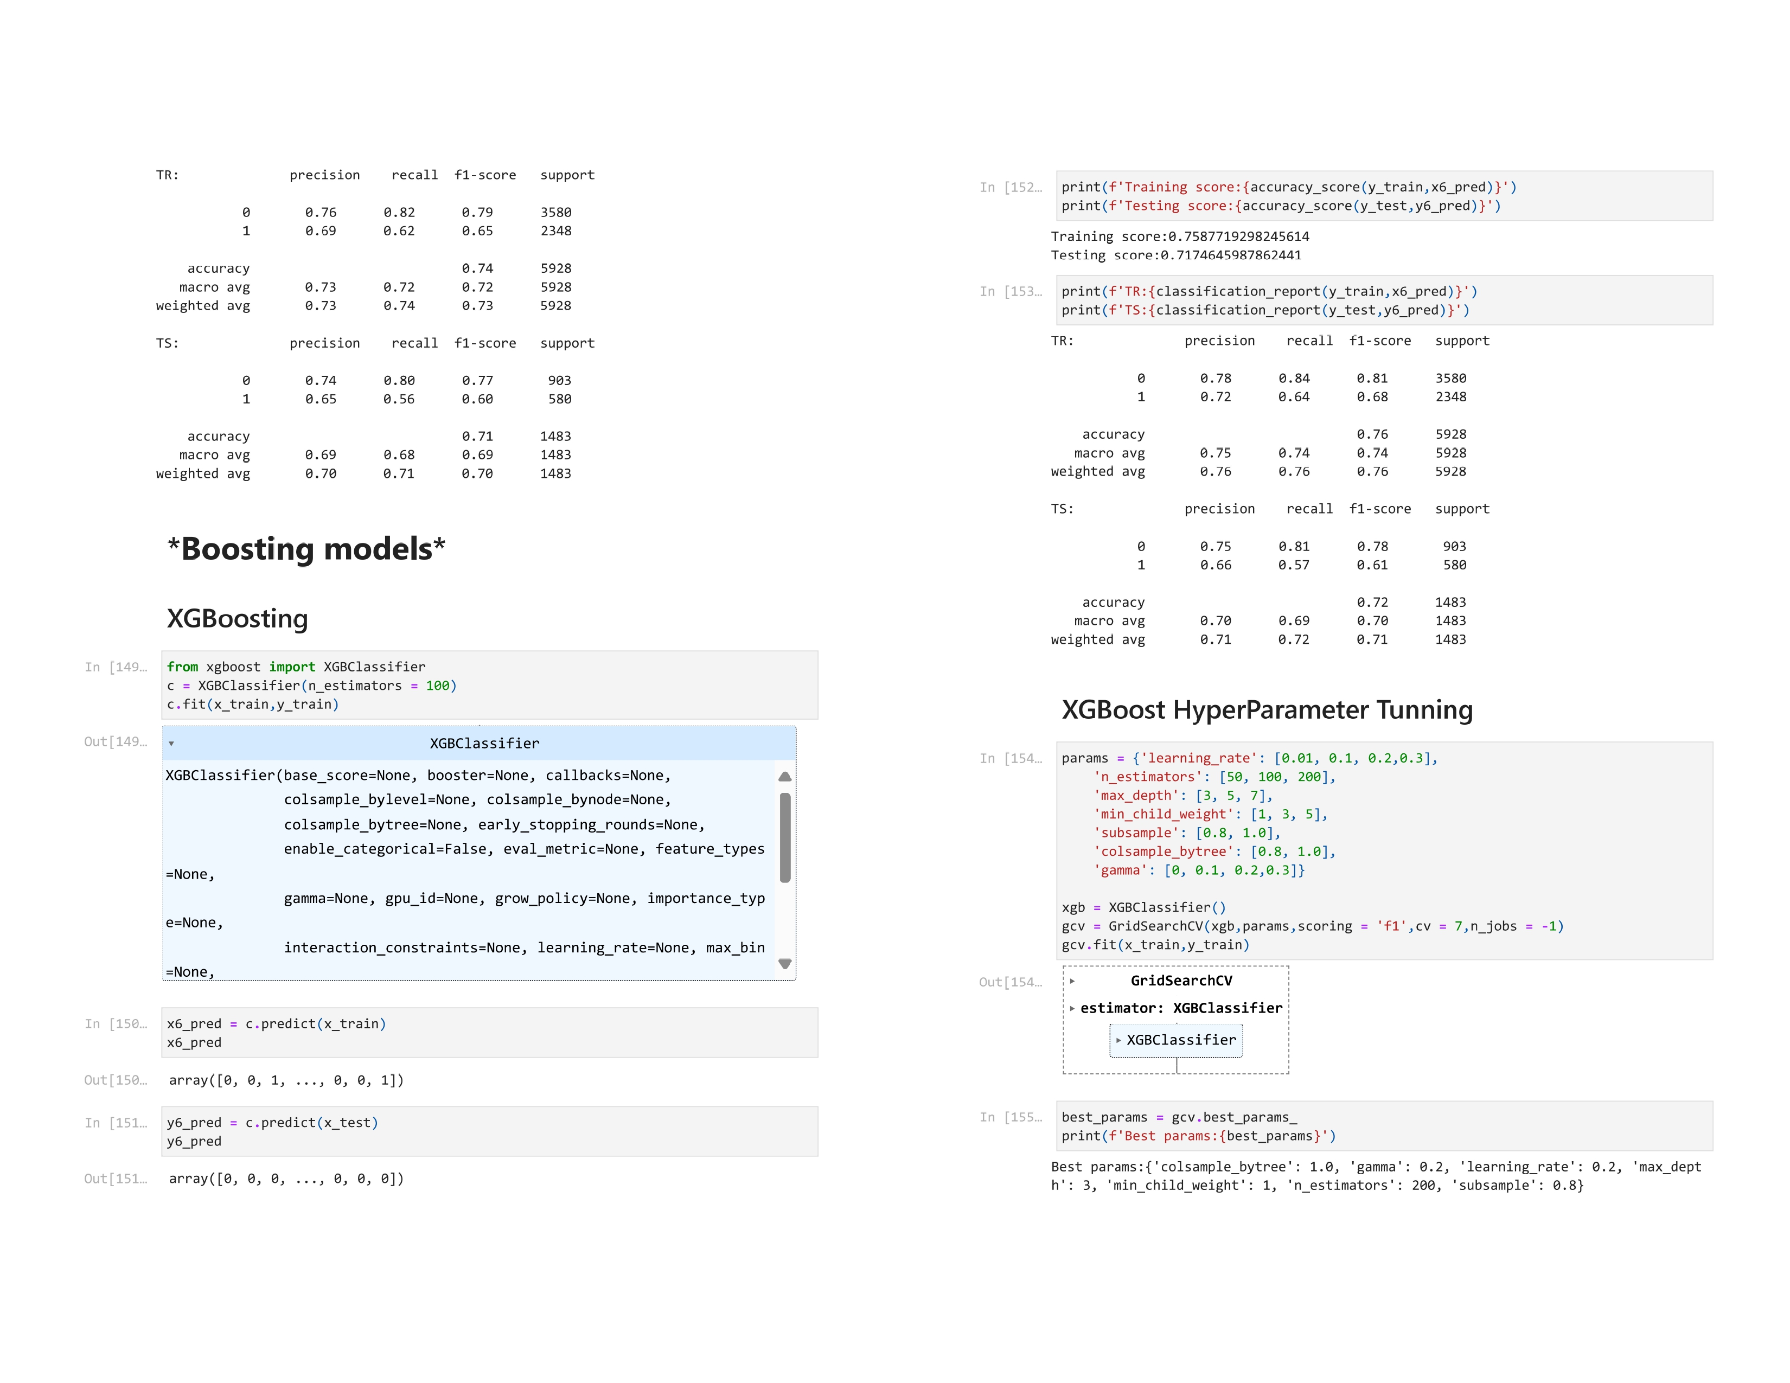

Slide 67
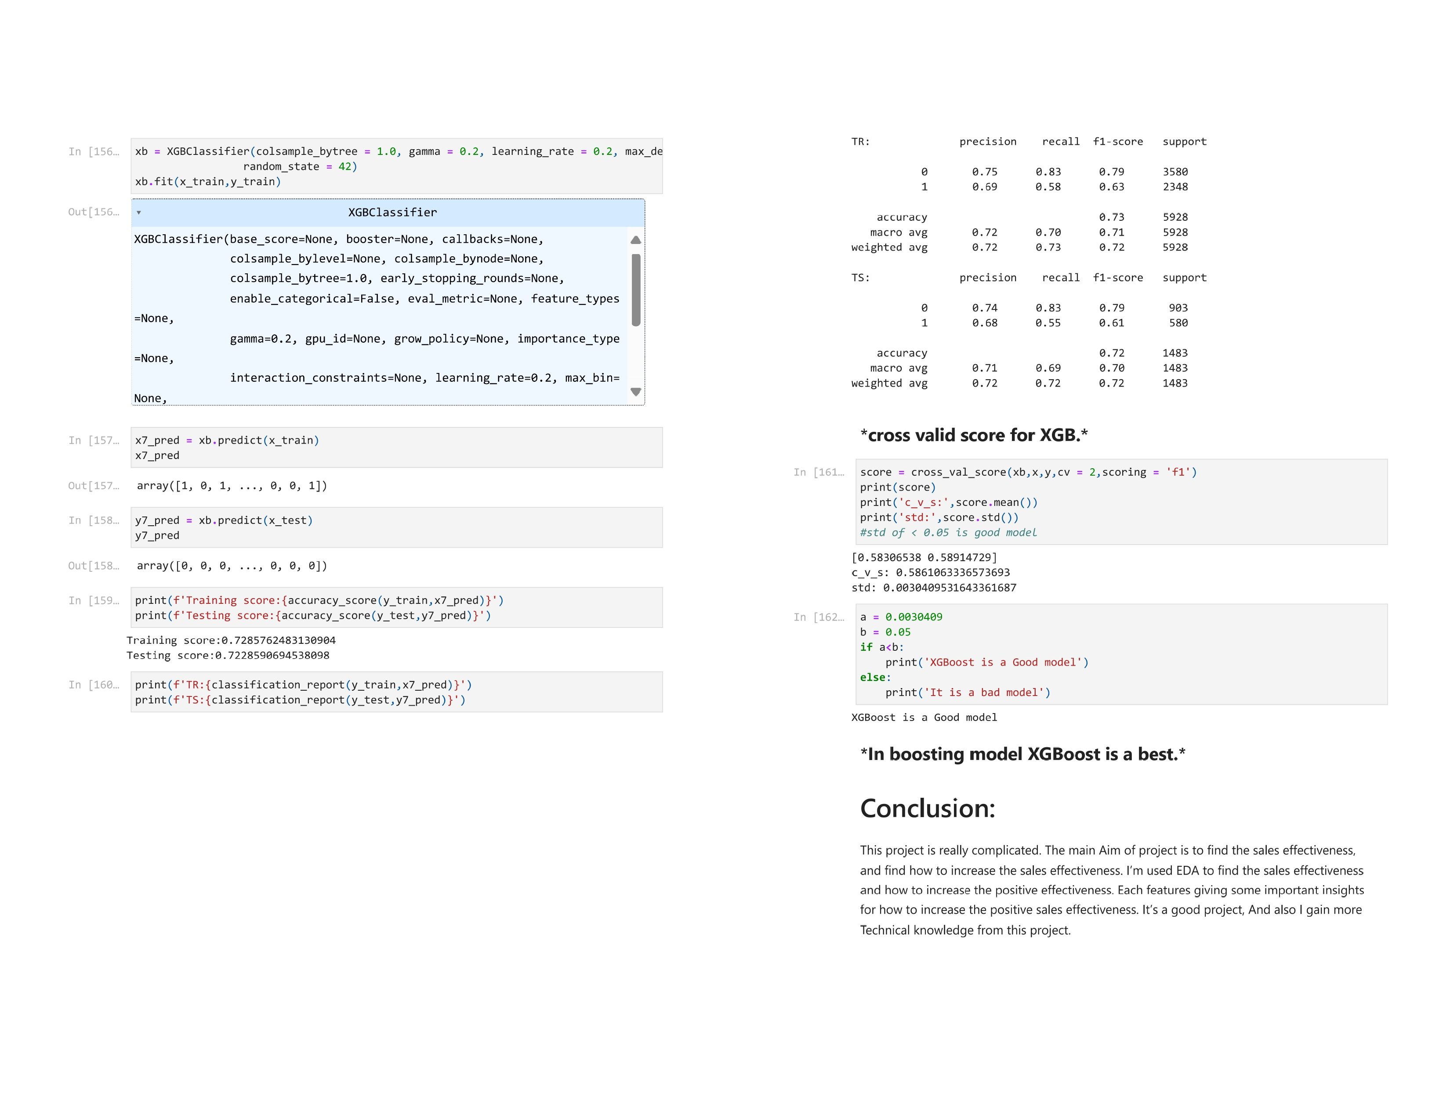

Slide 68
CONCLUSION
SOLUTION FOR THIS PROJECT
This project has been quite intricate, focusing primarily on determining sales effectiveness and devising strategies to enhance positive outcomes. Through exploratory data analysis (EDA), I've gained valuable insights into the factors influencing sales effectiveness and identified avenues for improvement. Each feature analyzed has provided significant insights into enhancing positive sales effectiveness, making it a rewarding learning experience. After evaluating seven different models, including XGBoost, Decision Tree, and Random Forest, it's clear that these three models stand out as the most suitable options. Cross validation scores indicate a high degree of consistency and reliability, with a standard deviation of less than 0.05 across these models. Moving forward, there are several key areas where positive sales effectiveness can be increased:
Projects: By focusing on products with IDs 18 to 20, which have demonstrated positive responses, and reducing emphasis on product 15, significant improvements can be achieved. Allocating more resources towards promoting and selling products with IDs 18 to 20 is likely to yield favourable results.
Source: Investing efforts in enhancing customer referral sources and leveraging existing client relationships can yield positive outcomes. These sources have shown promising responses, indicating their potential for driving sales effectiveness

Slide 69
Location: Prioritizing locations within India, particularly Bangalore and Chennai, can lead to improved sales effectiveness. Conversely, reducing emphasis on other locations, especially those outside India, may help mitigate negative responses and optimize resource allocation.
Sales Agent: Adjusting the allocation of tasks among sales agents based on performance can significantly impact sales effectiveness. Removing underperforming agents, such as Agent 5, and reallocating tasks to more successful agents, like Agents 9 and 10, can yield positive results.
Sales Agent in Location: Analysing sales agent performance across different locations reveals opportunities for optimization.
Agents tend to perform better in India compared to other locations, indicating a need to focus efforts accordingly. Additionally, targeting Asian countries where agent performance is currently lacking could yield untapped potential.
Delivery Mode: Focusing on delivery modes 2 and 3, which have shown strong performance, while phasing out mode 5 can streamline operations and enhance sales effectiveness.
Delivery Mode in Location: Aligning delivery mode distribution with location preferences can optimize outcomes. Prioritizing India and other high-performing locations while reducing emphasis on Asian countries, where delivery mode utilization is low, can lead to more efficient operations and improved sales effectiveness.
Overall, implementing these recommendations in a systematic manner can contribute to a significant enhancement in positive sales effectiveness, driving business growth and success.

Slide 70
REFERENCE

